Slide 1
NEW SPRINT
Sprint | BOIFUEMMYY
Particulars | To procure Boiler Fuel like Husk, Coal from time to time and also check for alternative fuel like wood, Saw Dust etc. To check the Gross Calorific Value and bringdown the fuel costs to the minimum levels.
Start Date | 01st Day of Month
End Date | Last Day of Month

Slide 2
SCRUM TEAM
Scrum Master | Scrum Master
Product Owner | Fuel Procurement Team
Developers | 1) Weighbridge 2) Logistics 3) Commercial 4) Stores 5) Boiler 6) Accounts 7) Quality Control

Slide 3
SCRUM EVENTS
Sprint | Entire Month
Sprint Planning | 01st Day of Month
Daily Scrum | 15 Minutes – Daily
Sprint Review | 25th Day of Month
Sprint Retro | Last Day of Month

Slide 4

PREVIOUS FINDINGS WITH TRADERS

Slide 5
Specifications of previous contracts executed by TDD and study the feasibility of buying coal wherein our lab can carry testing on those parameters, which will be easy for arriving debit calculations.
The following points to understand the difference between Traders (Old contract executed by TDD) & M/s. Adani Enterprises (Executed by KPT) for your ready reference.
What are the contract Terms with Traders for GCV (Contracts executed by TDD with Traders).
GCV ADB - 5300
What is the method of testing in our QC Lab.
GCV DB

Slide 6
Does our QC Lab can check GCV ADB.
No
What does our QC Lab mentioned in the Analysis Reports.
GCV 5300 & not mentioned ADB or DB or ARB
Does our Accounts taken GCV DB for calculating.
Yes
Does GCV DB or GCV ADB or GCV ARB – same.
No
What are the results of GCV DB of Traders as per Previous Analysis Reports.
GCV DB – 5300 to 5400
Any Deductions made to Traders for GCV
No

Slide 7
What are the results of GCV DB of M/s. Adani Enterprises tested in 3F Labs & outside.
Geochem CRT NO: CHE-CRT-23-24-01374 JOB REF NO: CHE-JB-2324-001385, dated 19/10/2023
GCV ADB – 5232, GCV DB – 6153, GCV ARB – 3496
Geochem CRT NO: CHE-CRT-2324-01847 JOB REF NO: CHE-JB-2324-001860, dated 08/01/2024
GCV ADB – 4997, GCV DB – 5913, GCV ARB – 3338
SGS Certificate No. 240104066C towards inspection from 27/11/2023 to 30/11/2023
GCV ARB – 3402, GCV DB – 6011
Email from Mr. Thammayya dated 26/12/2023 confirming GCV DB – 5522, 5533, 5561
Email from Mr. Thammayya dated 03/01/2024 confirming GCV DB – 5877,
GCV ARB - 3336

Slide 8
What are the standard terms for purchase of Coal.
GCV ARB (As Received Basis) & not GCV ADB (Air Dry Basis).
Attached Vessel COA – Vessel MV Epic
Important Observations.
We don’t have provision to check GCV in ADB Basis then why previous contracts by TDD in GCV ADB Basis.
We have provision to check GCV in ARB Basis as per recent purchases from KPT.
From the above, we can well understand the quality supplied by Traders in the previous years and also the quality supplied by M/s. Adani Enterprises.
Please note that M/s. Adani Enterprises is the single coal importer at Krishnapatnam and everyone has to buy from them whether it is for own use or trading purpose. We do agree that there are losses when we take deliveries during rains but we got some discount in the adani contracts as price adjustment.
Presently, we have started buying at Krishnapatnam after collection of quotations from Traders and Adani Enterprises

Slide 9
VESSEL COA
COAL SPECIFICATIONS

Slide 10
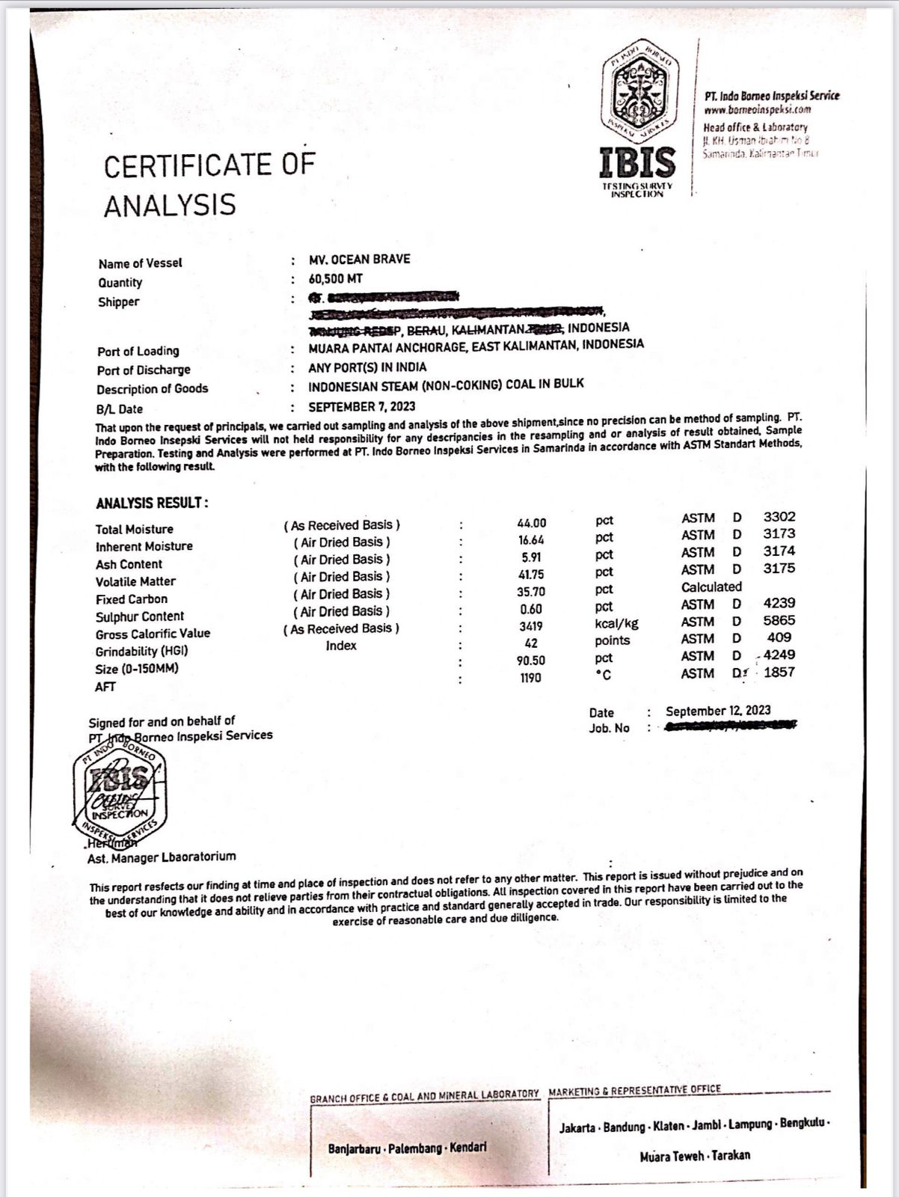

Slide 11
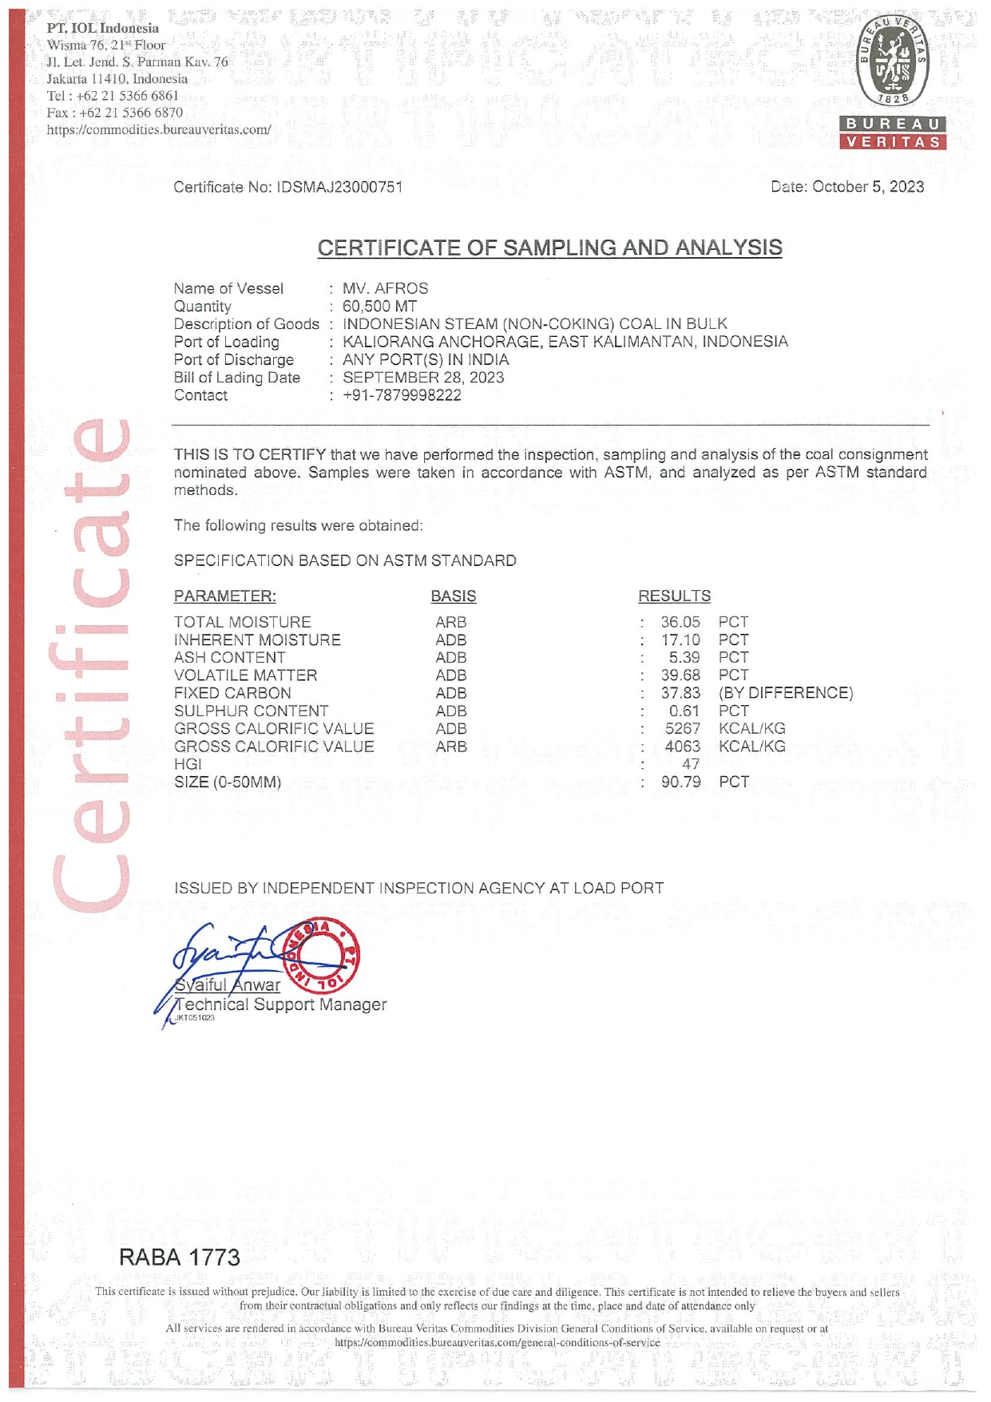

Slide 12
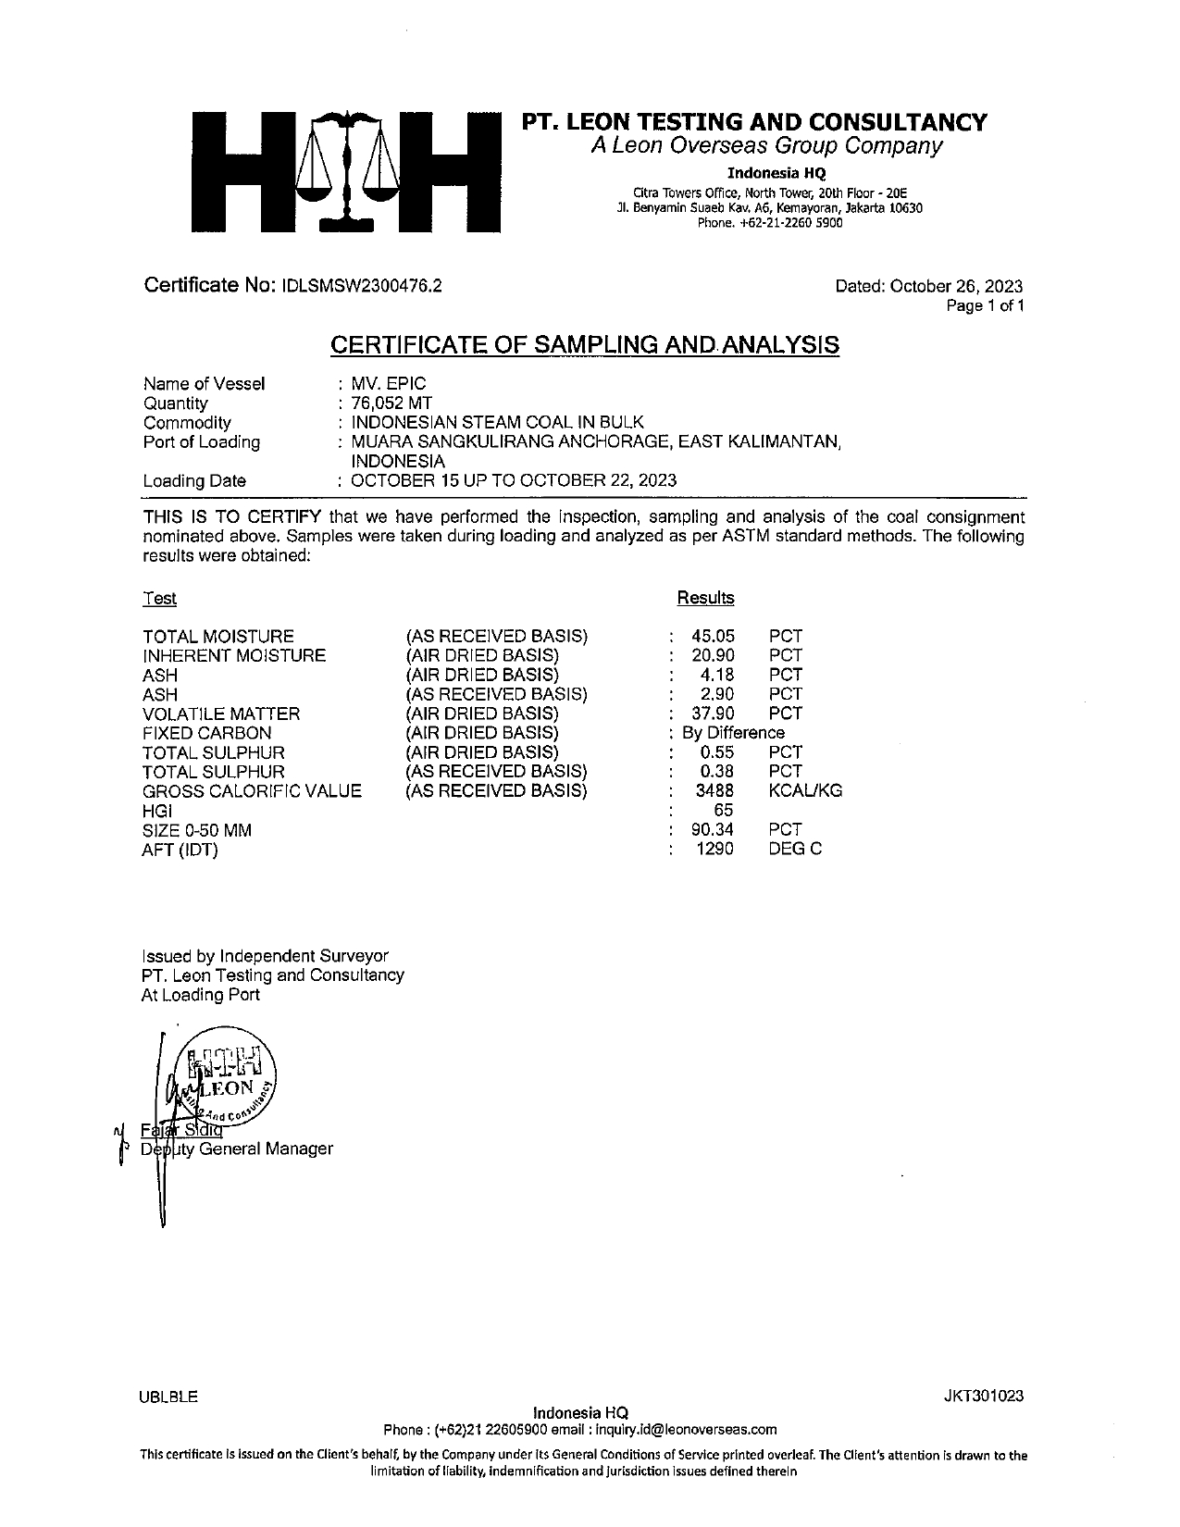

Slide 13
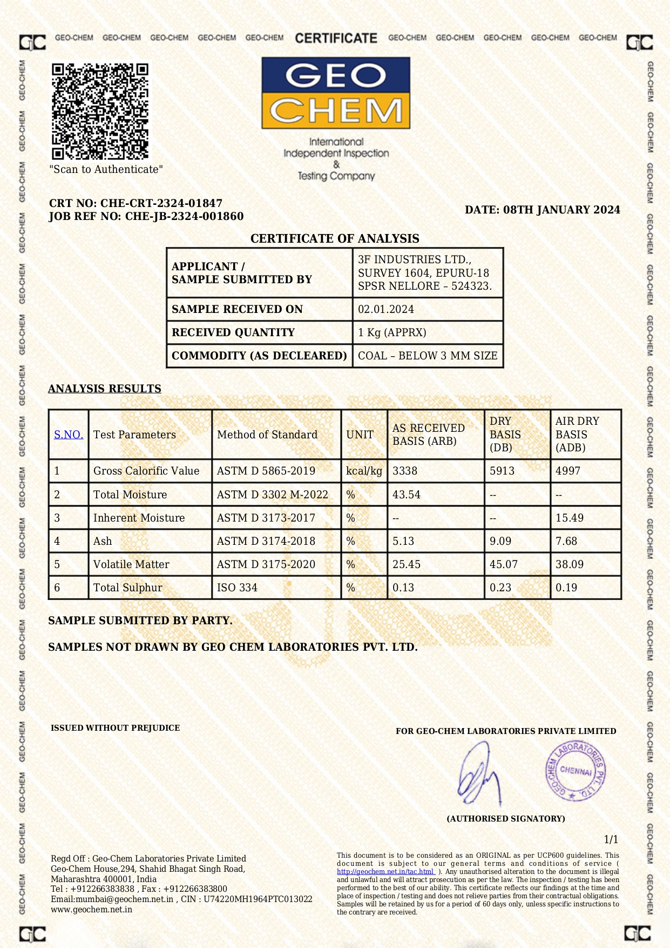

Slide 14
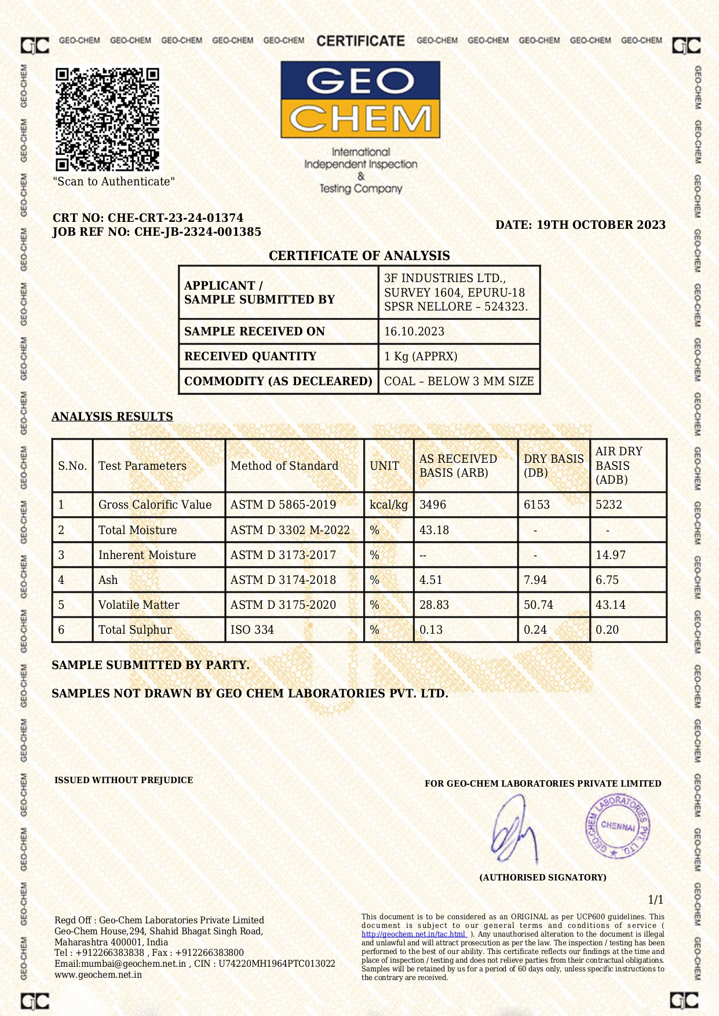

Slide 15
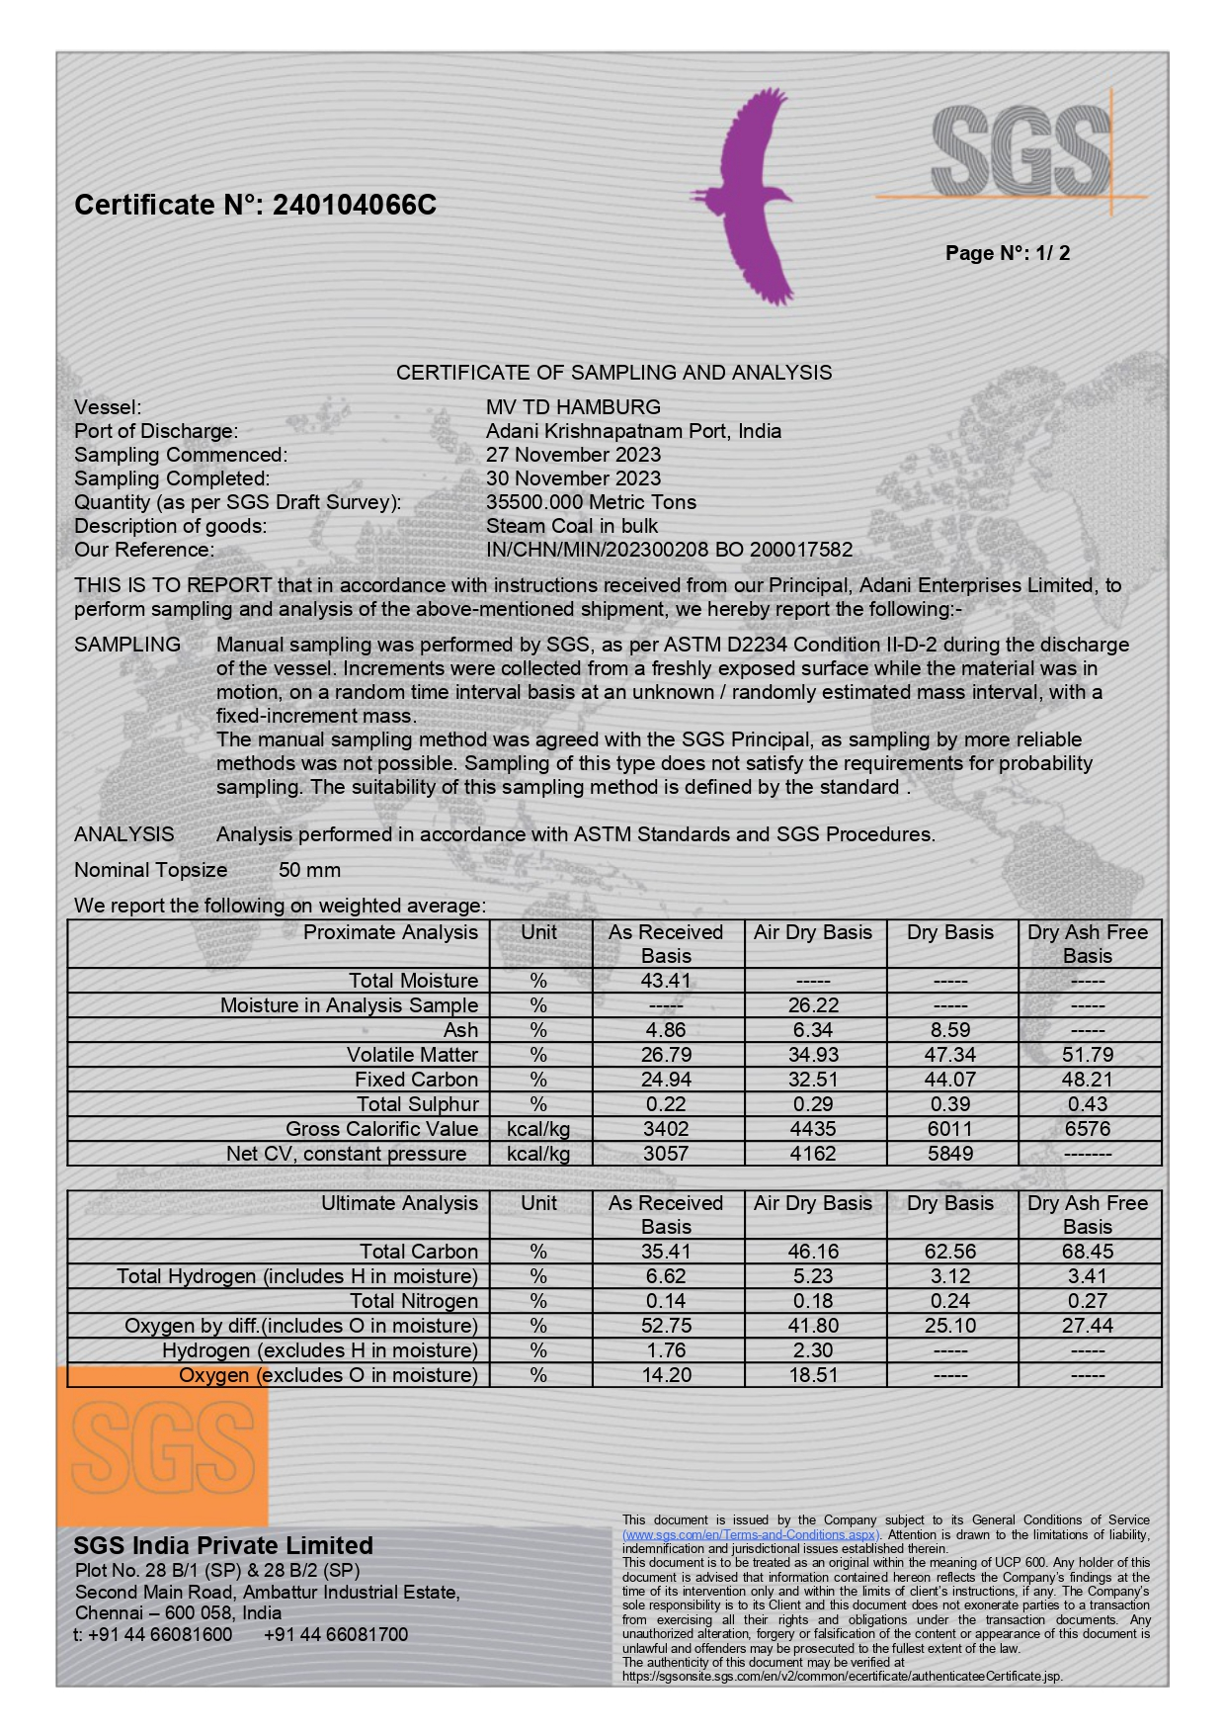

Slide 16
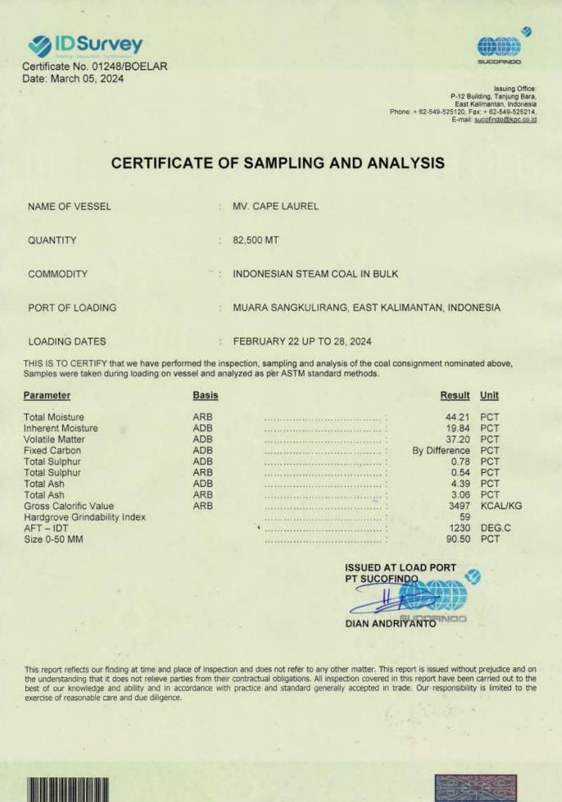

Slide 17
AS PER VESSEL COA’S
STANDARD SPECIFICATIONS
GCV – ARB
MOISTURE – ARB
ASH - ADB

Slide 18
OUR QC LAB HAS PROVISION FOR CHECKING
GCV – ARB
MOISTURE – ARB
ASH – DB ONLY

Slide 19
HENCE, WE CAN APPLY FORMULA TO CONVERT
DB TO ADB

Slide 20
GCV (DB) | GCV ADB / ( 1 - (INHERENT MOISTURE / 100) )
GCV (ADB) | GCV DB x ( 1 - (INHERENT MOISTURE / 100) )
GCV (ADB) | GCV ARB x (100 - INHERENT MOISTURE) / (100 - TOTAL MOISTURE)
GCV (ARB) | GCV ADB / ( (100 - INHERENT MOISTURE) / (100 - TOTAL MOISTURE) )

Slide 21
We are collecting quotes from Various Traders & Adani before finalization of New Coal Contract

Slide 22
STATEMENT SHOWING COAL QUOTES COMPARISON AS ON 08/01/2024
S.No. | SPECIFICATIONS | SUPPLIER | SUPPLIER | SUPPLIER | SUPPLIER
1 | SUPPLIER | ADANI | TOSHNIWAL | MAHALAKSHMI | SRIKRISHNA
2 | PRICE | 5125++ | 5300++ | 5649++ | 5650++
3 | GCV-ARB | 3400 +/- 100 | 3400 +/- 100 | 3400 +/- 100 | 3400 +/- 100
4 | TM-ARB | 45-47 | 43 +/- 1% | 38% | 38%
5 | IM-ADB | 18-20 | 15 +/- 1% | 13-16% | 16%
6 | VM-ADB | 39-41 |  | 38-42 | 38%
7 | ASH-ADB | 6-8 | 5 +/- 1% | 7% | 7%
8 | SULPHUR | <1 | <1 | <1 | <1
9 | SIZE | 0-50 MM | 0-50 MM | 0-50 MM | 0-50 MM
10 | GCV - ADB |  | 4800 - 5000
11 | FIXED CARBON | BY DIFFERENCE | BY DIFFERENCE | BY DIFFERENCE | BY DIFFERENCE

Slide 23
STATEMENT SHOWING COAL QUOTES COMPARISON AS ON 03/02/2024
S.No. | SPECIFICATIONS | SUPPLIER | SUPPLIER | SUPPLIER | SUPPLIER
1 | SUPPLIER | ADANI | TOSHNIWAL | MAHALAKSHMI | SRIKRISHNA
2 | PRICE | 5200++ | 5650++ | 5649++ | 5850++
3 | GCV-ARB | 3400 +/- 100 | 3400 +/- 100 | 3400 +/- 100 | 3400 +/- 100
4 | TM-ARB | 45-47 | 42 +/- 1% | 38% | 42%
5 | IM-ADB | 18-20 | 15 +/- 1% | 13-16% | 16%
6 | VM-ADB | 39-41 |  | 38-42 | 38%
7 | ASH-ADB | 6-8 | 5 +/- 1% | 7% | 7%
8 | SULPHUR | <1 | <1 | <1 | <1
9 | SIZE | 0-50 MM | 0-50 MM | 0-50 MM | 0-50 MM
10 | GCV - ADB |  | 4800 - 5000
11 | FIXED CARBON | BY DIFFERENCE | BY DIFFERENCE | BY DIFFERENCE | BY DIFFERENCE
12 | OFFER | New Offer | New Offer | Previous Offer | New Offer

Slide 24
STATEMENT SHOWING COAL QUOTES COMPARISON AS ON 12/03/2024
S.No. | SPECIFICATIONS | SUPPLIER | SUPPLIER | SUPPLIER | SUPPLIER | SUPPLIER | SUPPLIER
1 | SUPPLIER | Adani | Sri Krishna | Kriyas | Gowtham | Toshniwal | Tirumala
2 | PRICE | 5200++ | 5400++ | 5550++ | 5525++ | 5225++ | 5200++
3 | GCV-ARB | 3400 +/- 100 | 3400 +/- 100 | 3400 +/- 100 | 3400 +/- 100 | 3400 +/- 100 | 3400 +/- 100
4 | TM-ARB | 45-47 | 42 | 42-44 | 42-44 | 42-44 | 43-45
5 | IM-ADB | 18-20 | 16 | 14-17 | 13-16 | 15-16 | 16-18
6 | VM-ADB | 39-41 | 38 | 37-39 | 42 |  | 38-42
7 | ASH-ADB | 6-8 | 7 | 3-6 | 7 | 5-6 | 6-7
8 | SULPHUR | <1 | <1 | <1 | <1 | <1 | <1
9 | SIZE | 0-50 MM | 0-50 MM | 0-50 MM | 0-50 MM | 0-50 MM | 0-50 MM
10 | FIXED CARBON | BY DIFFERENCE | BY DIFFERENCE | BY DIFFERENCE | BY DIFFERENCE | BY DIFFERENCE | BY DIFFERENCE
11 | WEIGHMENT | PORT W/B | 3F W/B | PORT W/B | PORT W/B | 3F W/B | 3F W/B

Slide 25
STATEMENT SHOWING COAL QUOTES COMPARISON AS ON 01/04/2024
S.No. | SPECIFICATIONS | SUPPLIER | SUPPLIER | SUPPLIER
1 | SUPPLIER | Adani | Tirumala | Toshniwal
2 | PRICE | 5675.00 | 5325.00 | 6100.00
3 | CESS @ 5% | 283.75 | 266.25 | 305.00
4 | HANDLING | 0.00 | 500.00 | 0.00
5 | CESS @ 400 PMT | 400.00 | 400.00 | 400.00
6 | GST @ 18% ON HANDLING | 0.00 | 90.00 | 0.00
7 | TOTAL PMT | 6358.75 | 6581.25 | 6805.00
8 | GCV-ARB | 3800 +/- 100 | 3800 +/- 100 | 3800 +/- 100
9 | TM-ARB | 37-39 | 39-41 | 39-41
10 | IM-ADB | 15-19 | 17-18 | 15-16
11 | VM-ADB | 42-44 | 40-42 | 40-42
12 | ASH-ADB | 3-5 | 7-9 | 5-6
13 | SULPHUR | <1 | <1 | <1
14 | SIZE | 0-50 MM | 0-50 MM | 0-50 MM
15 | FIXED CARBON | BY DIFFERENCE | BY DIFFERENCE | BY DIFFERENCE
16 | WEIGHMENT | PORT W/B | 3F W/B | 3F W/B

Slide 26
STATEMENT SHOWING COAL QUOTES COMPARISON AS ON 30/04/2024
S.No. | SPECIFICATIONS | SUPPLIER | SUPPLIER | SUPPLIER | SUPPLIER
1 | SUPPLIER | Adani | Tirumala | Krishna Inter. | Toshniwal
2 | PRICE | 5185.00 | 4900.00 | 5350.00 | 5470.00
3 | GST @ 5% | 259.25 | 245.00 | 267.50 | 273.50
4 | HANDLING | 0.00 | 500.00 | 0.00 | 0.00
5 | CESS @ 400 PMT | 400.00 | 400.00 | 400.00 | 400.00
6 | GST @ 18% ON HANDLING | 0.00 | 90.00 | 0.00 | 0.00
7 | TOTAL PMT | 5844.25 | 6135.00 | 6017.50 | 6143.50
8 | GCV-ARB | 3400 +/- 100 | 3400 +/- 100 | 3400 +/- 100 | 3400 +/- 100
9 | TM-ARB | 45-47 | 45-47 | 45-47 | 42-44
10 | IM-ADB | 18-20 | 18-20 | 18-20 | 15-16
11 | VM-ADB | 39-41 | 39-41 | 39-41 | 39-41
12 | ASH-ADB | 7-8 | 7-8 | 7-8 | 5-6
13 | SULPHUR | <1 | <1 | <1 | <1
14 | SIZE | 0-50 MM | 0-50 MM | 0-50 MM | 0-50 MM
15 | FIXED CARBON | BY DIFFERENCE | BY DIFFERENCE | BY DIFFERENCE | BY DIFFERENCE
16 | WEIGHMENT | PORT W/B | 3F W/B | 3F W/B | 3F W/B
17 | PAYMENT | Advance | Credit 15 days | Advance | Credit 15 days

Slide 27
EFFECT OF
TOTAL MOISTURE
IN COAL

Slide 28
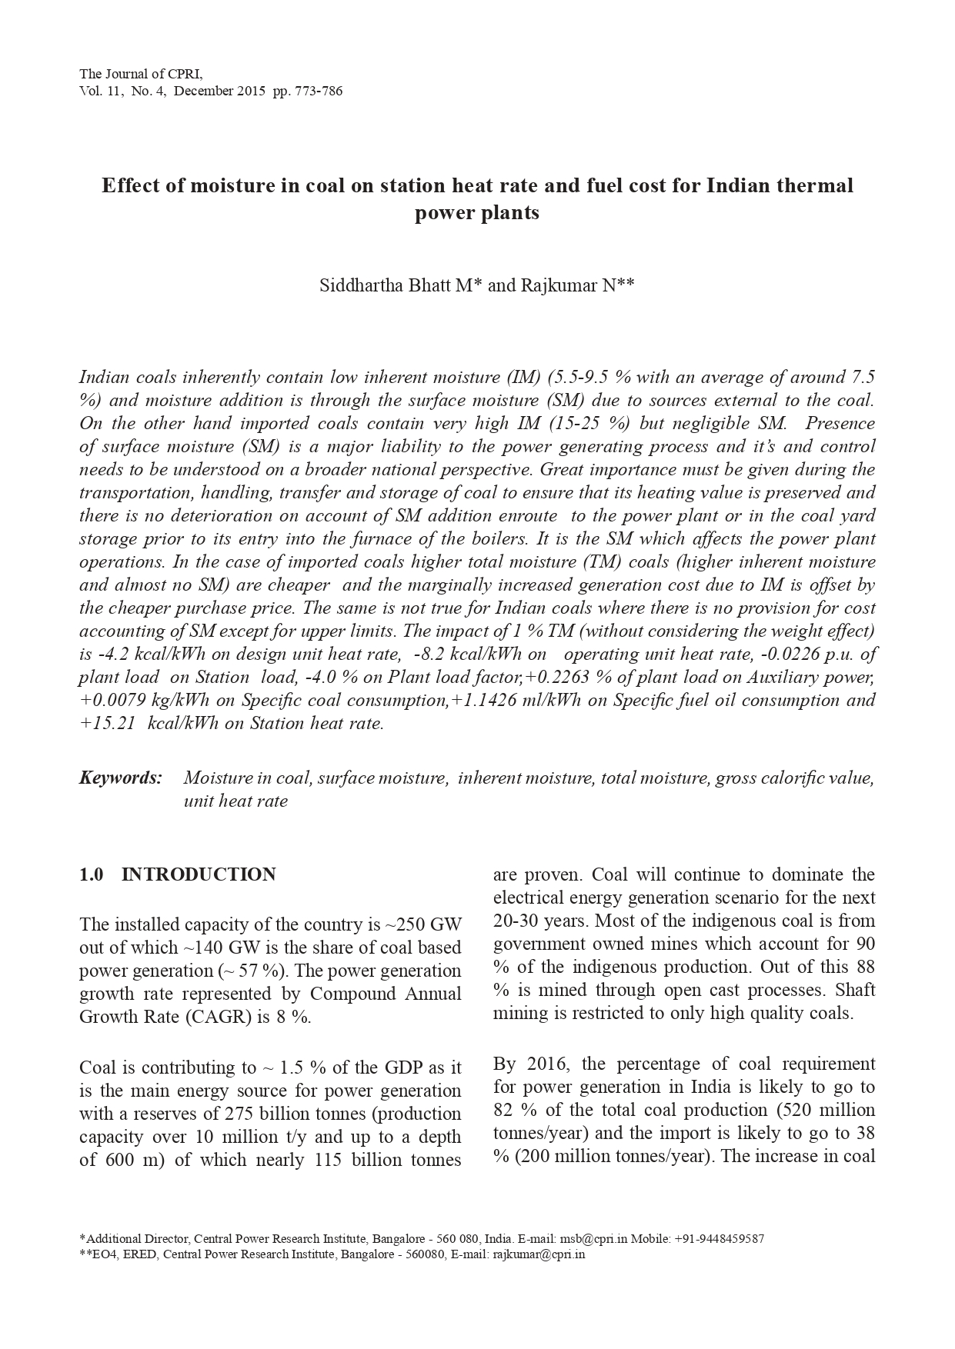

Slide 29
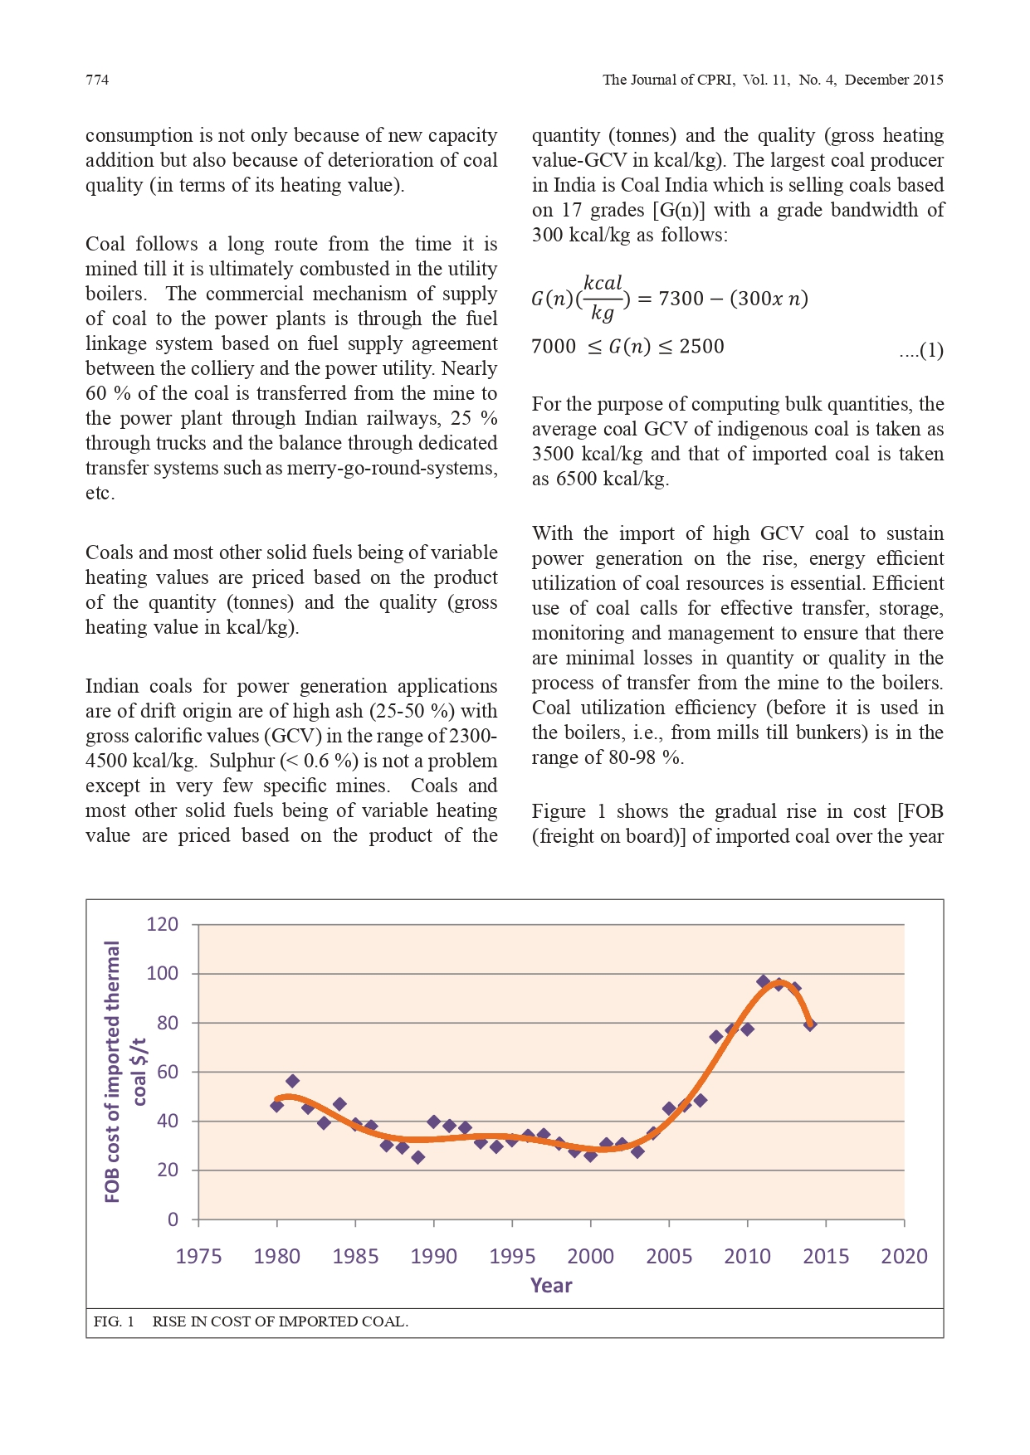

Slide 30
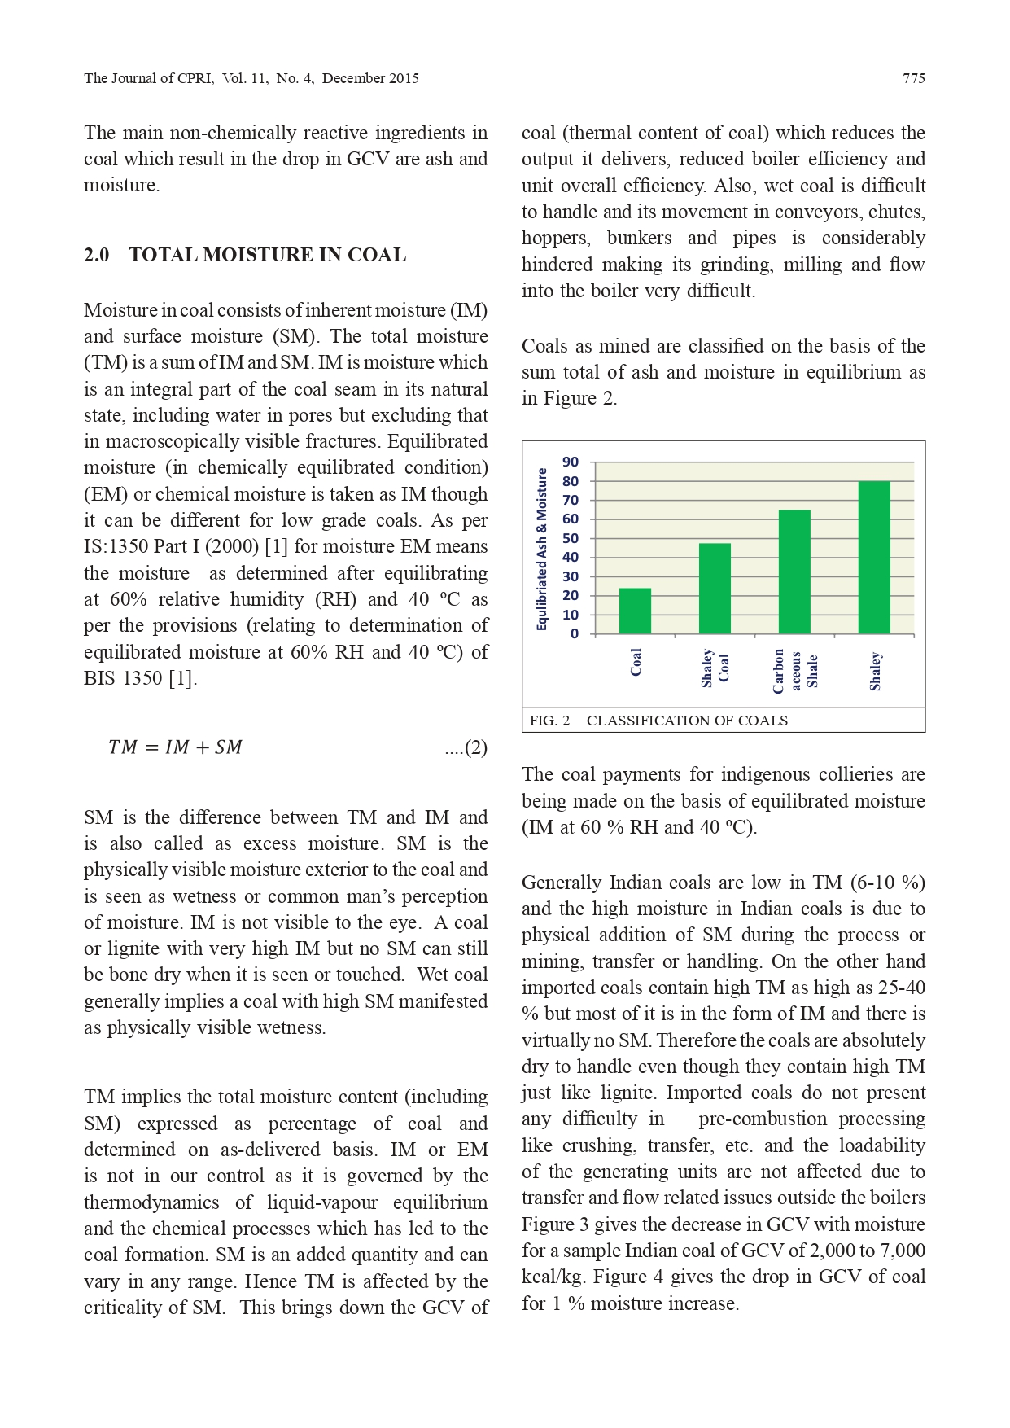

Slide 31
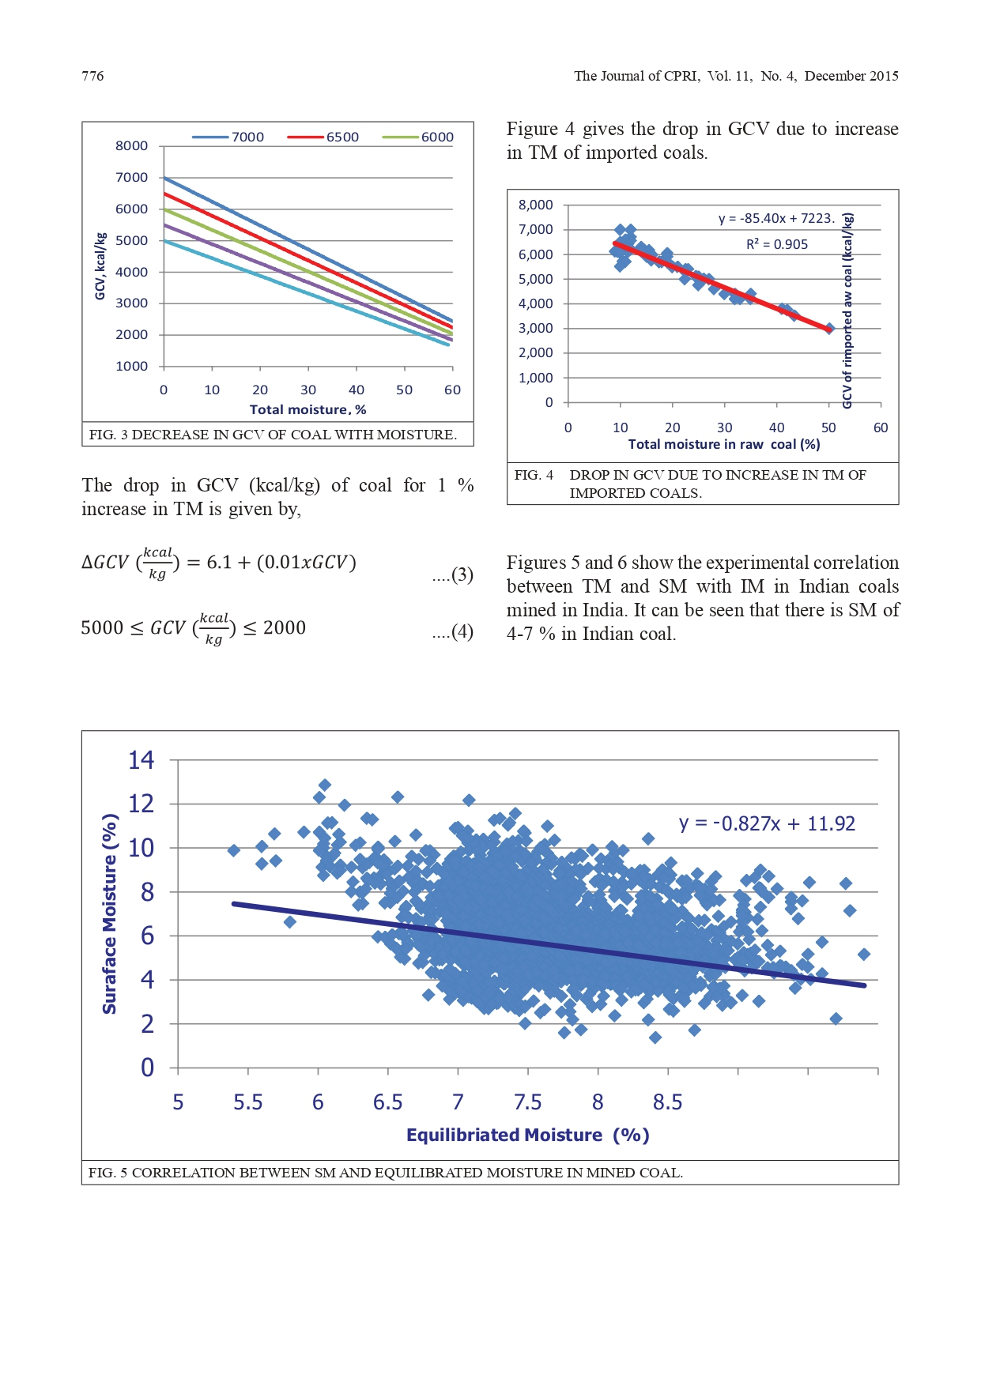

Slide 32
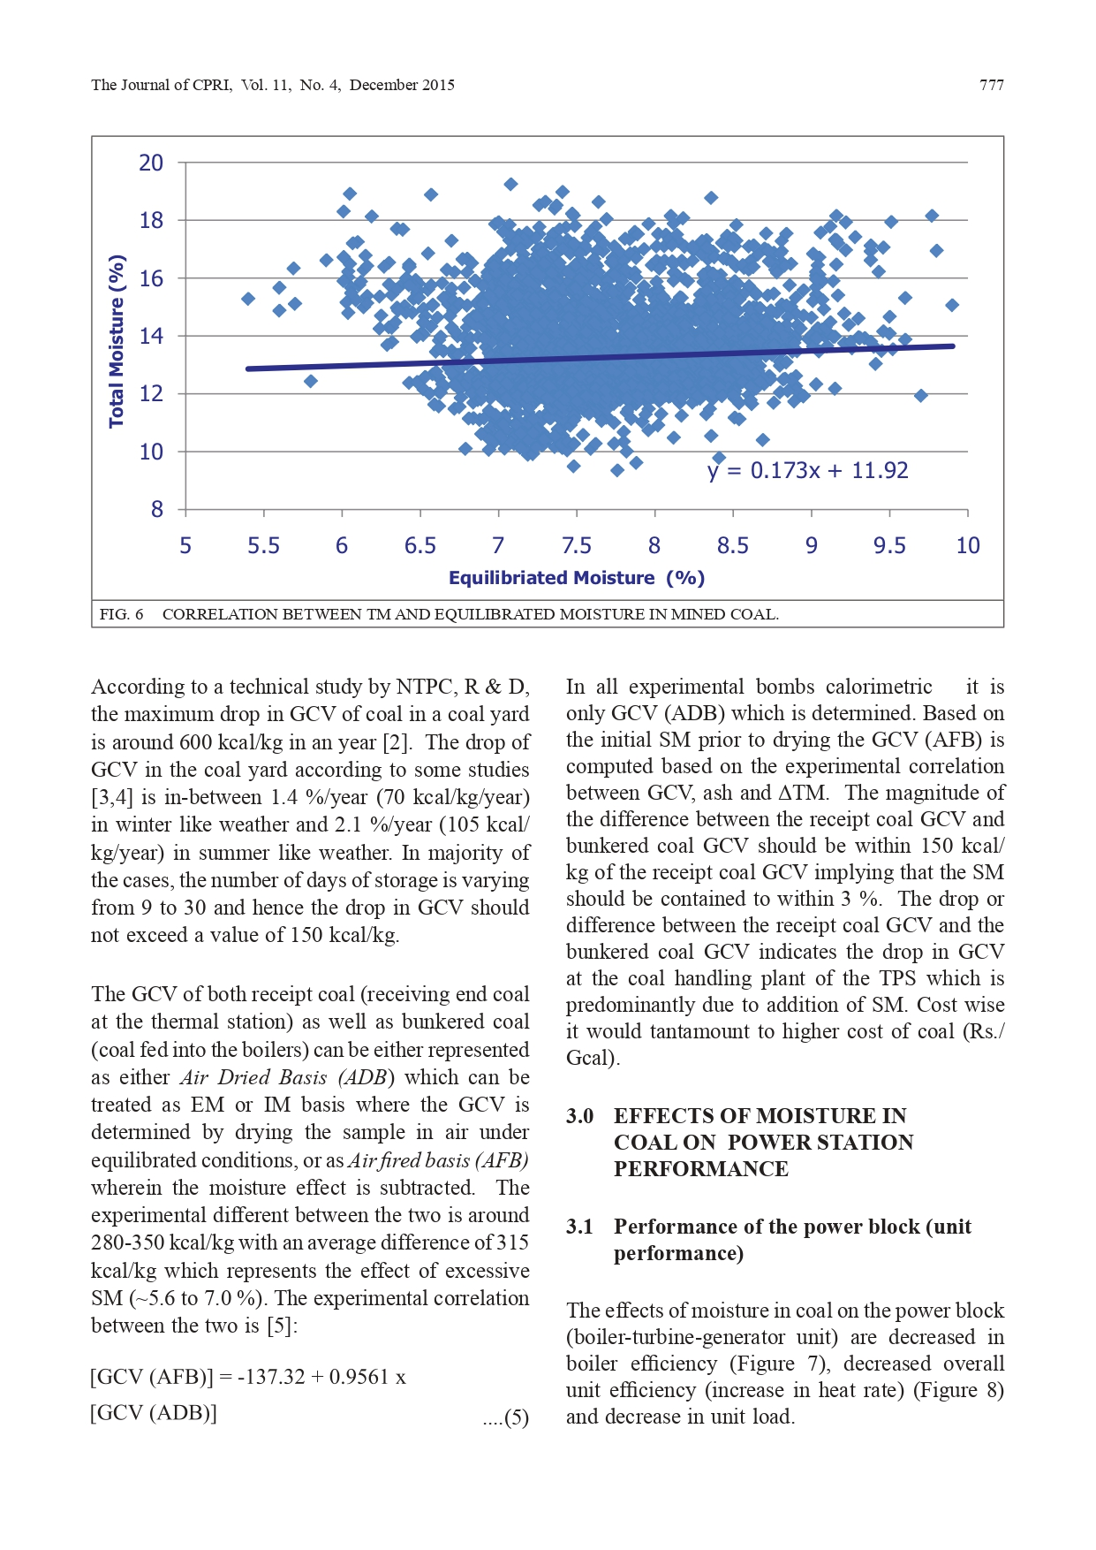

Slide 33
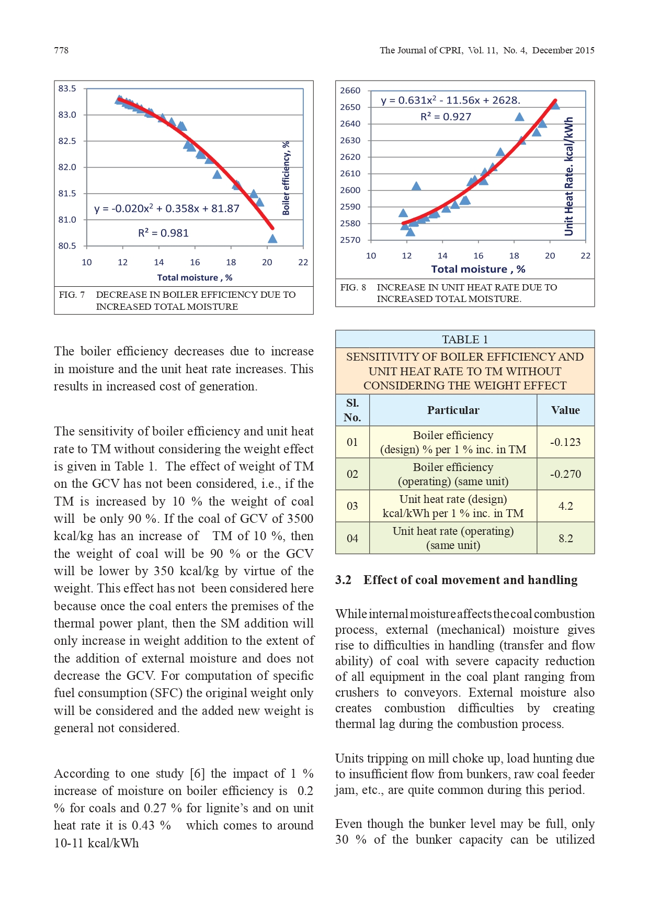

Slide 34
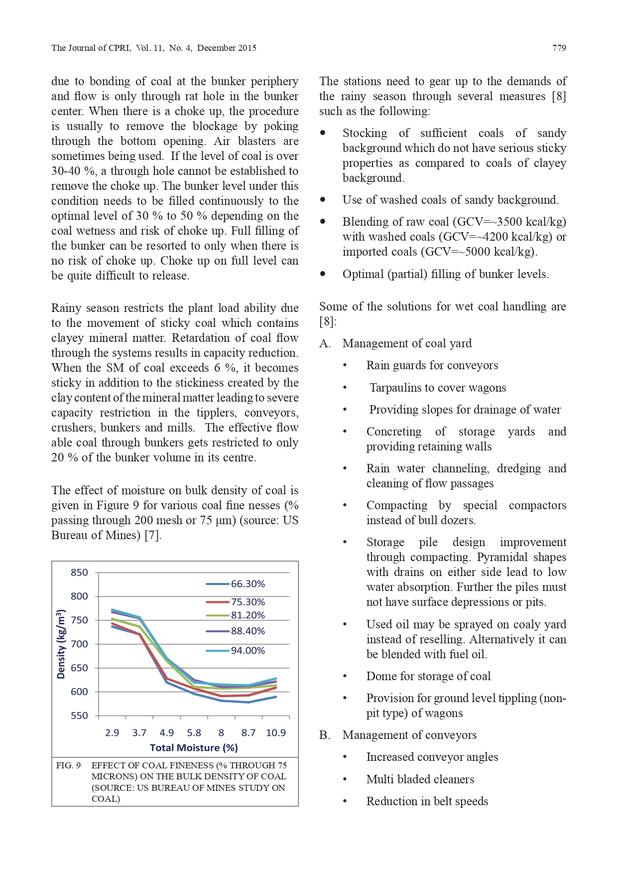

Slide 35
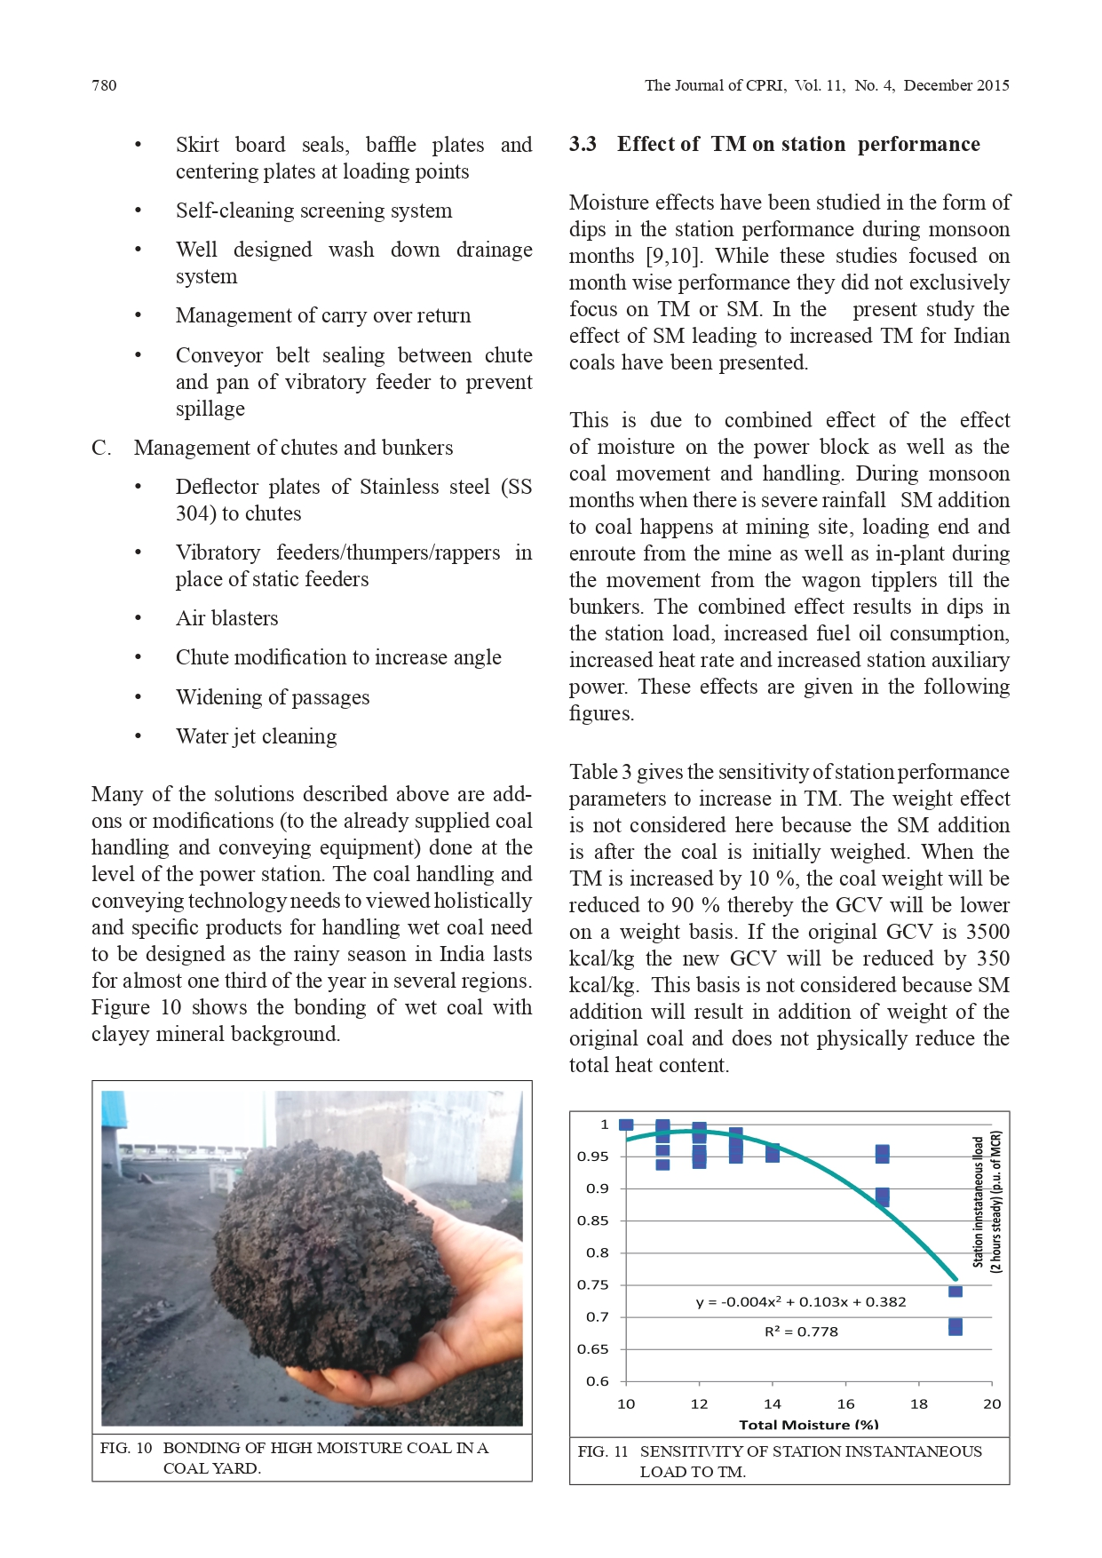

Slide 36
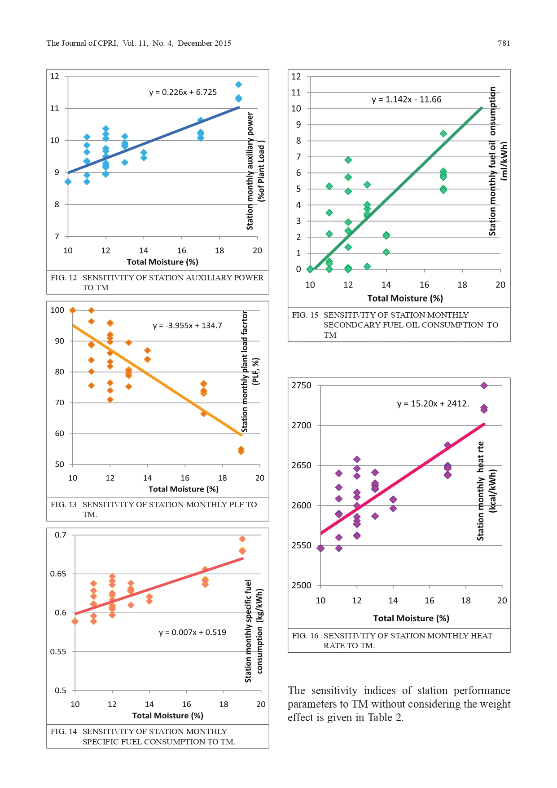

Slide 37
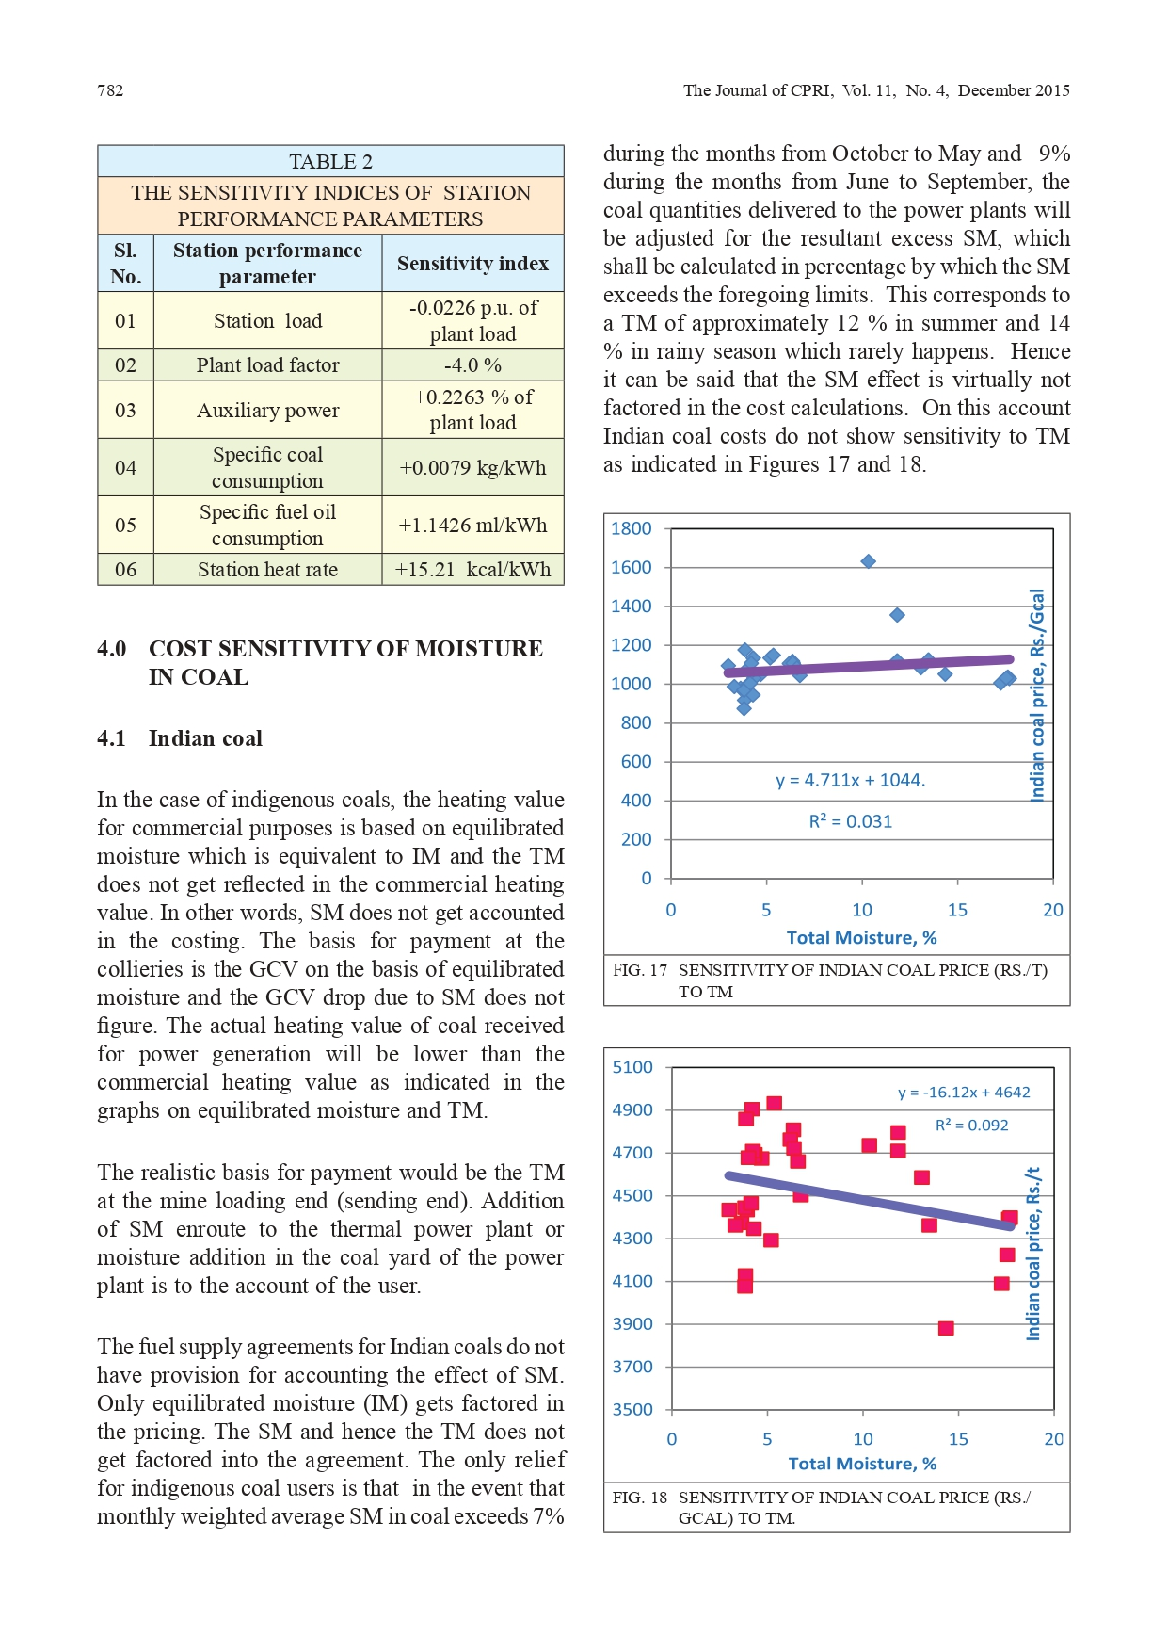

Slide 38
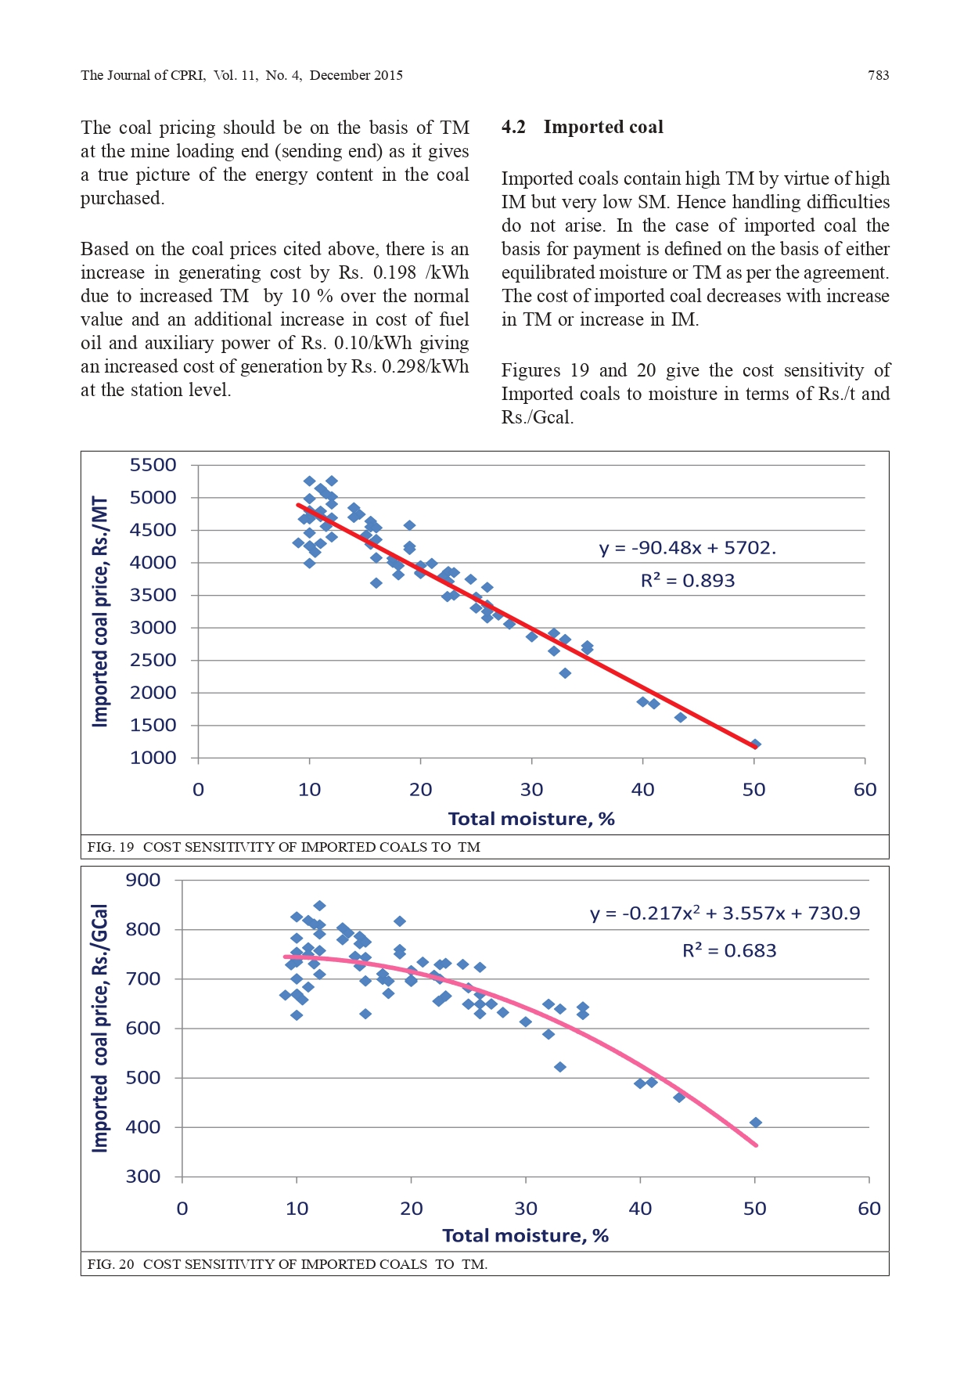

Slide 39
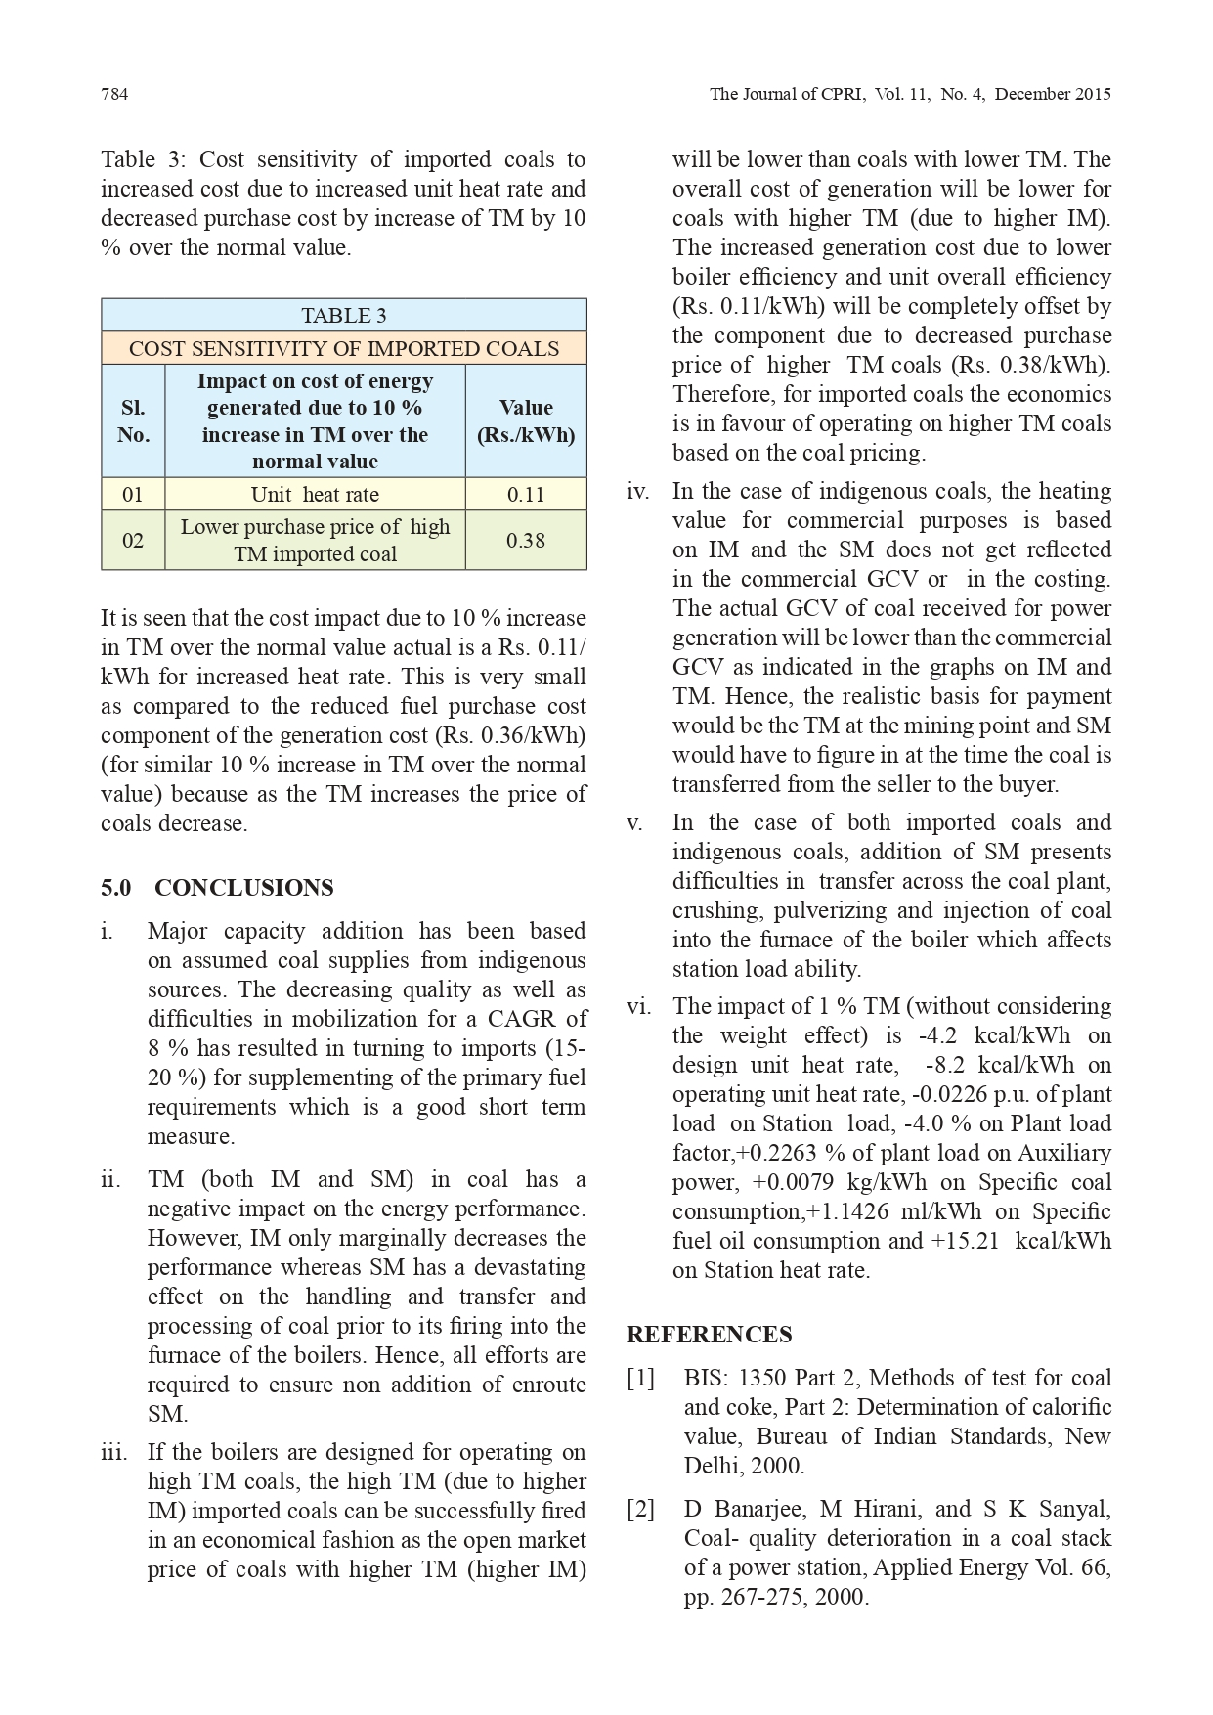

Slide 40
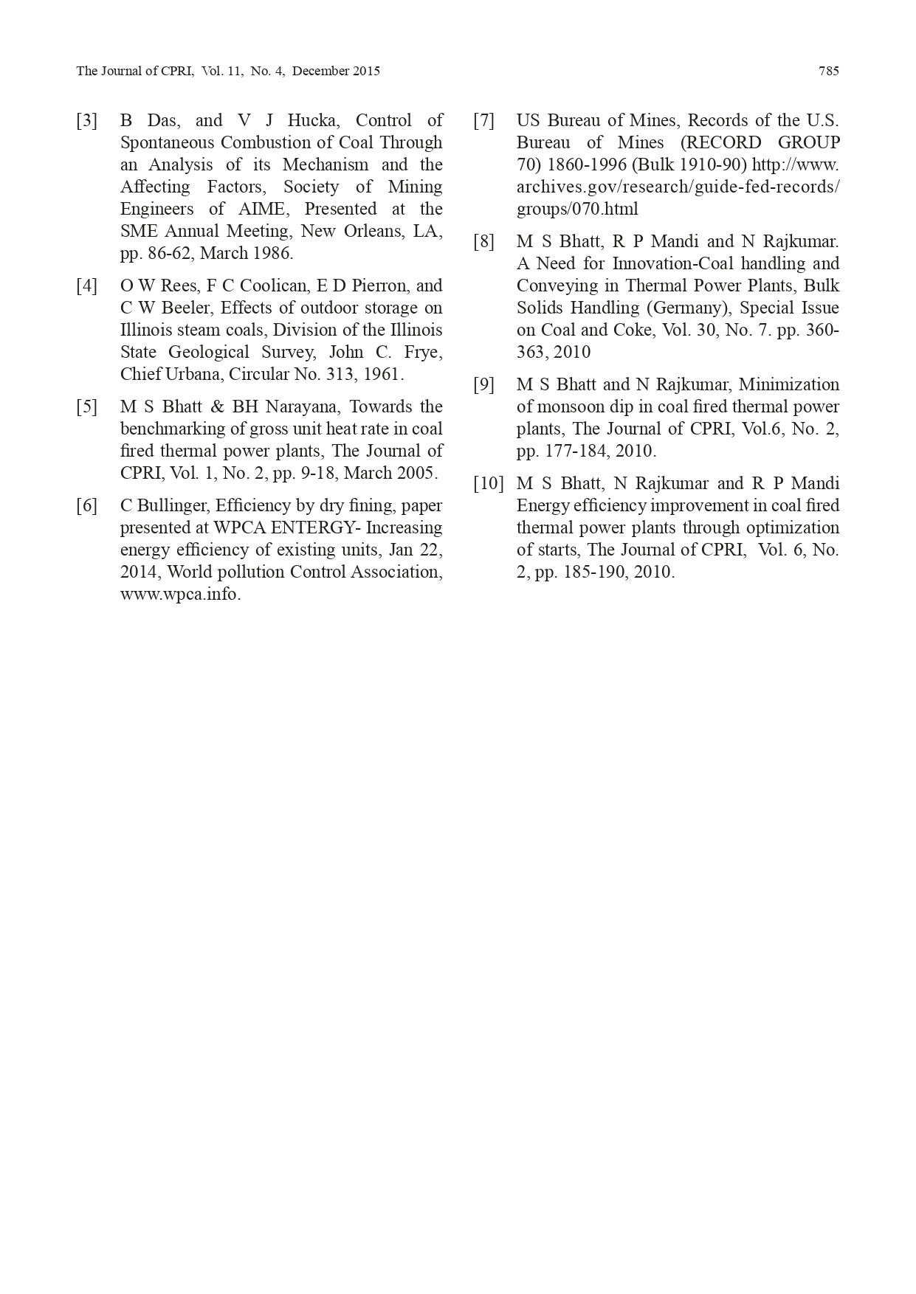

Slide 41
From the above slides, it was noted as below.
Total Moisture = Inherent Moisture + Surface Moisture
if the TM is increased by 10 % the weight of coal will be only 90 %. If the coal of GCV of 3500 kcal/kg has an increase of TM of 10 %, then the weight of coal will be 90 % or the GCV will be lower by 350 kcal/kg by virtue of the weight. This effect has not been considered here because once the coal enters the premises of the thermal power plant, then the SM addition will only increase in weight addition to the extent of the addition of external moisture and does not decrease the GCV. For computation of specific fuel consumption (SFC) the original weight only will be considered and the added new weight is general not considered
According to one study [6] the impact of 1 % increase of moisture on boiler efficiency is 0.2 % for coals and 0.27 % for lignite’s and on unit heat rate it is 0.43 % which comes to around 10-11 kcal/kWh
It can be tested, by taking 2 samples of 1 kg. (First Sample) & 990 Grams (2nd sample) adding 10 grams water to make 1 Kg. Both samples become 1 kg. each and GCV (ARB) can be checked to observe the difference of impact of GCV by increase in 10% TM, which will make you understand the actual loss.
When the GCV is checked in GCV (As Received Basis) then Ash & TM losses are included since based on this, there will be impact in GCV

Slide 42
DETAILS OF HUSK
&
COAL PURCHASES
FOR 2022-23 &
2023-24

Slide 43
PURCHASE OF COAL FOR YEAR 2022-23
MONTH | Party Inv Val | DC Qty | RATE | BASIC VALUE | Total GST Value 5% | CESS Value 400/-PMT | WITH OUT GST
Jul-22 | 3,515,637 | 453.63 | 7,750 | 3,175,414 | 158,771 | 181,452 | 7,400
Aug-22 | 6,036,625 | 777.20 | 7,767 | 5,453,091 | 272,655 | 310,880 | 7,416
Sep-22 | 5,260,650 | 669.72 | 7,855 | 4,755,011 | 237,751 | 267,888 | 7,500
0CT-22 | 23,923,036 | 3,601.89 | 6,642 | 21,810,006 | 1,013,710 | 1,047,776 | 6,346
Nov-22 | 27,471,700 | 3,480.16 | 7,894 | 24,837,748 | 1,241,887 | 1,392,064 | 7,537
Dec-22 | 2,934,072 | 361.45 | 8,118 | 2,656,659 | 132,833 | 144,580 | 7,750
Jan-23 | 1,027,199 | 130.77 | 7,855 | 928,467 | 46,423 | 52,308 | 7,500
Feb-23 | 13,681,538 | 1,959.11 | 6,984 | 12,358,930 | 613,480 | 709,136 | 6,670
Mar-23 | 41,644,881 | 7,695.33 | 5,412 | 37,310,800 | 2,041,372 | 2,292,732 | 5,146

Slide 44
PURCHASE OF COAL FOR YEAR 2023-24
MONTH | Party Inv Val | DC Qty | RATE | BASIC VALUE | GST 5% | CESS 400/-PMT | WITH OUT GST
Apr-23 | 10,354,494 | 2,163.51 | 4,786 | 9,261,252 | 533,003 | 560,244 | 4,540
May-23 | 3,824,065 | 714.29 | 5,354 | 3,430,038 | 189,687 | 204,340 | 5,088
Sep-23 | 2,542,310 | 344.37 | 7,382 | 2,290,059 | 105,695 | 127,152 | 7,019
Oct-23 | 15,233,047 | 2,433.21 | 6,260 | 13,580,727 | 679,036 | 973,284 | 5,981
Nov-23 | 17,698,521 | 2,797.43 | 6,327 | 15,790,047 | 789,502 | 1,118,972 | 6,044
Dec-23 | 8,664,122 | 1,395.63 | 6,208 | 7,729,514 | 386,476 | 548,132 | 5,931
Jan-24 | 15,705,981 | 2,685.88 | 5,848 | 13,964,706 | 698,235 | 1,043,040 | 5,588
Feb-24 | 10,897,328 | 2,035.73 | 5353 | 9,669,017 | 467,214 | 720,644 | 5,104
Mar-24 |  |  | 5860 | 5200 | 260 | 400 | 5600

Slide 45
01-04-2023 TO 29-02-2024 |  |  |  |  | 01-04-2022 TO 29-02-2023
Bill Pass | Pay Qty | RATE | Material Value |  | Bill Pass | Pay Qty | RATE | Material Value
Apr-23 | 1,634.060 | 6,958 | 11,369,924 |  | Apr-22 | 5,340.870 | 4,862 | 25,968,163
May-23 | 4,396.930 | 6,092 | 26,784,444 |  | May-22 | 6,092.840 | 4,008 | 24,420,845
Jun-23 | 3,847.040 | 5,587 | 21,491,672 |  | Jun-22 | 5,095.970 | 4,459 | 22,720,728
Jul-23 | 3,756.860 | 5,265 | 19,779,485 |  | Jul-22 | 5,293.880 | 4,434 | 23,470,749
Aug-23 | 4,379.210 | 5,654 | 24,758,947 |  | Aug-22 | 5,753.200 | 5,202 | 29,930,499
Sep-23 | 3,719.750 | 5,360 | 19,938,104 |  | Sep-22 | 4,711.000 | 5,209 | 24,538,485
Oct-23 | 2,362.060 | 5,989 | 14,145,597 |  | Oct-22 | 4,273.840 | 6,175 | 26,390,164
Nov-23 | 2,599.480 | 6,762 | 17,577,794 |  | Nov-22 | 3,576.590 | 6,916 | 24,737,148
Dec-23 | 3,789.870 | 5,964 | 22,602,416 |  | Dec-22 | 5,247.620 | 6,595 | 34,609,165
Jan-24 | 2,350.060 | 5,970 | 14,029,715 |  | Jan-23 | 4,932.150 | 6,812 | 33,598,722
Feb-24 | 2,566.850 | 6,017 | 15,445,157 |  | Feb-23 | 2,584.150 | 7,058 | 18,237,770
Mar-24 |  |  |  |  | Mar-23 | 1,515.190 | 7758 | 11,754,897
Total : | 35,402.170 | 5873.18 | 207,923,255 |  | Total : | 54,417.300 | 5520 | 300,377,335

Slide 46
UNACCOUNTED
BOILER
CONSUMPTIONS
NOTICED

Slide 47
Particulars | Jun-23 | Jul-23 | Aug-23 | Sep-23 | Oct-23 | Nov-23 | Dec-23
Total Steam Generated & Consumed | 12,186 | 10,937 | 12,862 | 13,583 | 15,390 | 15,458 | 14,406
Condensate return to Boiler | 1,766 | 1,416 | 1,900 | 1,850 | 56 | 1,718 | 1,508
% Condensate return to Boiler | 14 | 13 | 15 | 14 | 0 | 11 | 10
Fuel Consumption:
STEAM COAL (IMPORTED) |  |  |  | 629 | 2,549 | 2,432 | 1,488
HUSK | 3,213 | 2,898 | 3,461 | 3,001 | 1,552 | 1,666 | 2,636
GROUNDNUT SHELL |  |  |  |  |  |  | 2
Total Fuel Consumption | 3,213 | 2,898 | 3,461 | 3,630 | 4,101 | 4,098 | 4,126
Steam Generated per ton of Fuel Con. | 3.79 | 3.77 | 3.72 | 3.74 | 3.75 | 3.77 | 3.49
From the table above, it is evident that the condensate return in December 2023 was 10%, compared to the previous months of 14 to 15%. The shortfall (15 - 10 = 5%) had been compensated for makeup DM water, amounting to 744m3, necessitating additional steam to raise the temperature to 105°C in the deaerator. Consequently, this resulted in an extra 25T of fuel consumption, as detailed below.

Slide 48
Average steam production = 20TPH | Condensate shortage (i.e. 10% instead of 15%) = 5% of 20tph = 1m3/hr | (1*24*31)=744m3 for the month of Dec | Additional steam required for 744m3 of DM water = 90t | Add fuel consumption = 25MT
There were plant stoppages noticed and idle operations in the TFH’s are as below in Dec23 and the details are as below.
Production stopped on : 04.12.23 at 6.00 AM | Idle operation hours = 6 hrs | 54 Hrs | Approx. husk consumption = 1.25tph*54*2 heaters | Total consumption due to idle operation = 135 MT
TF Heaters stopped on 04.12.23 at 12 Noon
TF Heaters re-started on 08.12.23 at 6.00 AM | Idle operation hours = 48 hrs
Production resumed on : 10.12.23 at 9.00 AM

Slide 49
In addition to the above (A & B), we received fuels with high moisture content due to severe cyclone (Michaung) impact. This increased moisture led to higher fuel consumption, totaling around 60MT.
Conclusion: Taking into account of the cumulative impacts outlined in points A, B, and C, the total additional fuel consumption amounts to 220MT (25+135+60=220); Consequently, the ratio of steam generated per ton of fuel consumption stands at 3.7

Slide 50
COAL ANALYSIS REPORTS BY
3F QC LAB - KPT

Slide 51
SUMMARY OF COAL ANALYSIS RESULTS
S.No. | Period | Supplier | Results | Total Moisture | ASH CONTENT | GCV
1 | Jan-24 | Adani Enterprises | Standards | 45-47 (ARB) | DB | 3300 - 3400 (ARB)
 |  |  | As per QC | 45 | 11 | 3371
2 | Feb-24 | Adani Enterprises | Standards | 45-47 (ARB) | DB | 3300 - 3400 (ARB)
 |  |  | As per QC | 43 | 10 | 3324
3 | Mar-24 | Adani Enterprises | Standards | 45-47 (ARB) | DB | 3300 - 3400 (ARB)
 |  |  | As per QC | 39 | 11 | 3356
4 | Mar-24 | Tirumala Enterprises | Standards | 43-45 (ARB) | DB | 3300 - 3400 (ARB)
 |  |  | As per QC | 40 | 8 | 3306
5 | Mar-24 | Toshniwal Enterpirses | Standards | 42-44 (ARB) | DB | 3300 - 3400 (ARB)
 |  |  | As per QC | 41 | 9 | 3313
5 | Apr-24 | Adani Enterprises | Standards | 37-39 (ARB) | DB | 3700 - 3800 (ARB)
 |  |  | As per QC | 38 | 6 | 3755
6 | May-24 | Adani Enterprises | Standards | 37-39 (ARB) | DB | 3700 - 3800 (ARB)
 |  |  | As per QC | 40 | 7 | 3556
6 | May-24 | Adani Enterprises | Standards | 45-47 (ARB) | DB | 3300 - 3400 (ARB)
 |  |  | As per QC | 40 | 5 | 3623

Slide 53
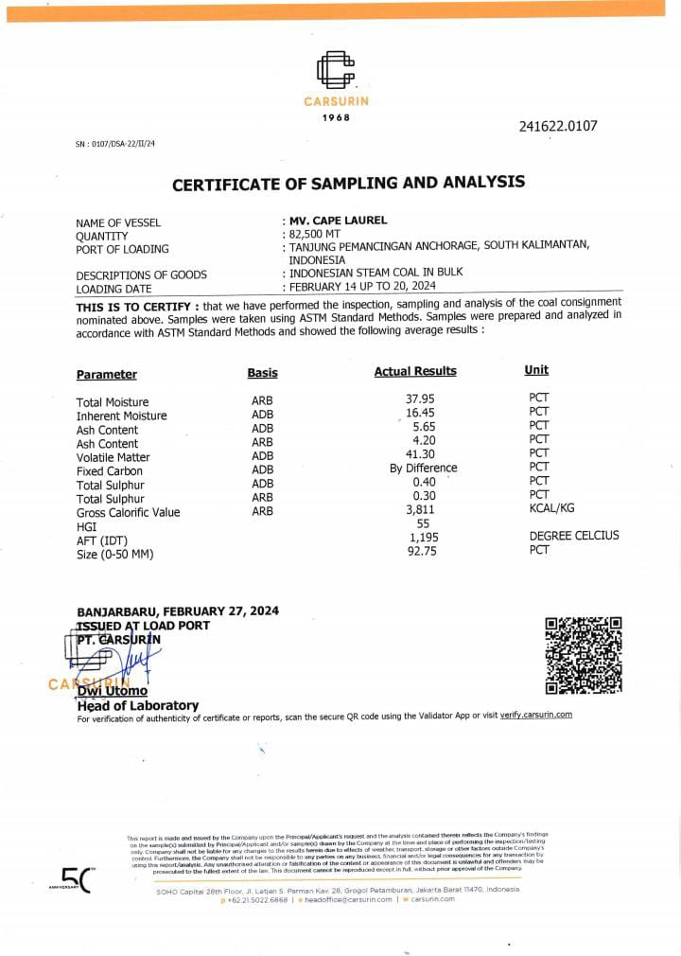

Slide 54
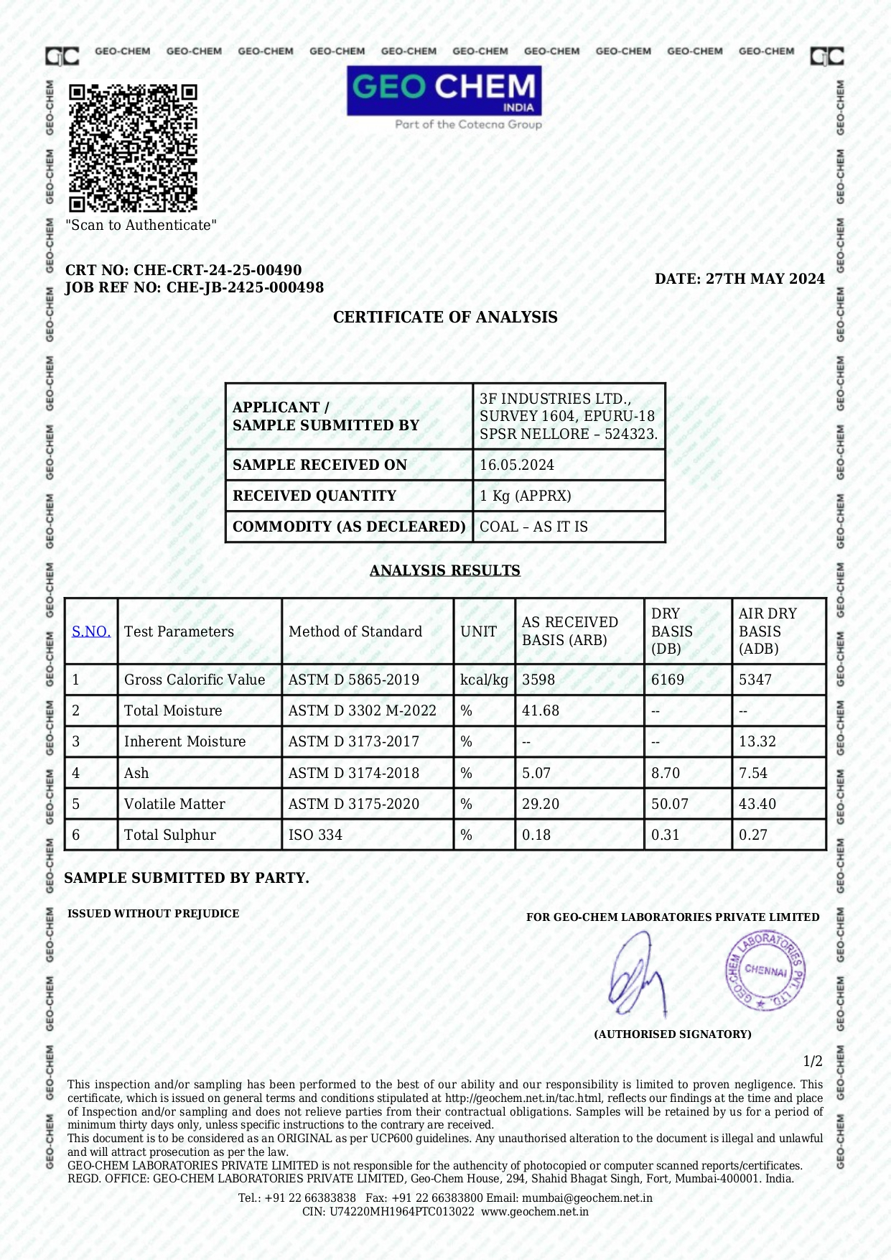

Slide 55
From the results, you will notice the following.
GCV for Adani supplies given as 3755 against 3700-3800 GCV
GCV for Adani supplies given as 3556 against 3700-3800 GCV
GCV for Adani supplies given as 3623 against 3300-3400 GCV
From S.No. 2-3, we can understand that there is issue with the lab testing results when compared with respective Vessel COA
Earllier, Coal Contracts are finalized with GCV 5300 ADB inspite of not having the provision to check GCV in ADB basis.
Our 3F QC Labs used to check GCV DB basis and our Accounts taken the same as GCV ADB for loss calculations.
Presently, we are purchasing 3400 GCV ARB from Adani and same is standard specifications as per various COA’s
Our Labs have the provision to check GCV ARB

Slide 56
SENIOR MANAGEMENT HAS INSTRUCTED TO BUY COAL FROM ADANI AFTER CHECKING PROS/CONS AND INSTRUCTED NOT TO ENTERTAIN ANY TRADERS

Slide 57
COMPARISION OF
HUSK PRICES VERSUS COAL PRICES
IS CARRIED AND
ACCORDINGLY, UTILISATION IS PLANNED

Slide 58
IT IS KNOWN FACT THAT GCV OF HUSK IS LESSER THAN GCV OF COAL BUT AS PER BOILER SECTION – THEY ARE SHOWING 1:1

Slide 59
COMPARISON OF COAL VERSUS HUSK
The following calculation is coal quality with 38% moisture.
Moisture content as received basses (ARB) is 38 %
COAL
38% moisture coal GCV = 5500 X 0.38 = 2090, so 5500 – 2090 = 3410 ,
To lift the 38% moisture in coal we are calculating how much energy required Q=mcP Delta T , Delta T = 110 – 30 Deg C = 80 Deg C
M = 1000 kgs
Specific heat of Coal cP = 1.26
Q = 1000X80X1.26 = 1,00,800K.Cal
100800/3410 = 29.56kg, on % basis 2.96 required So roughly considered 3%
3410 X 0.03 : 102 , 3410- 102 = 3308 K cal/kg,

Slide 60
COMPARISON OF COAL VERSUS HUSK
Husk
GCV of HUSK on dry basis 3200 – 3400, on average basis 3300 Kcal/kg, 3300x0.1 = 330, 3300 – 330 = 29700 Kcal /kg
M = 1000 kgs
Specific heat of Rice Husk cP = 0.4
Q = 1000X80X0.4 = 32000 K.Cal /kg
32000/2970 = 10.77 kg, on % basis 1.07 required So roughly considered 1%
2970 X 0.01 : 29.7 , 2970- 29.7 = 2940 K cal/kg,
So approximately coal and husk consumption = 3308 / 2940 = 1 : 1.12 ratio. But actual ratio is depending on the boiler operations.

Slide 61
SUMMARY OF CONSUMPTION WITH COAL/HUSK AS PER 3F KPT QC RESULTS
S.No. | Period | Supplier | Total Moisture | Ash Content | GCV | Delta T = 110-30 Deg. C = 80 Deg C | M = 1000 Kgs | Specific Heat of Coal cP = 1.26 | Q = 1000 x 80 x 1.26 | On % basis per Kg. | On % basis per MT | Loss in GCV | Coal Efficiency | Husk Efficiency | Ratio
1 | Jan-24 | Adani | 45 | 11 | 3371 | 80 | 1000 | 1.26 | 100800 | 29.9 | 0.03 | 100.8 | 3270 | 2940 | 1.11
2 | Feb-24 | Adani | 43 | 10 | 3324 | 80 | 1000 | 1.26 | 100800 | 30.3 | 0.03 | 100.8 | 3223 | 2940 | 1.10
3 | Mar-24 | Adani | 39 | 11 | 3356 | 80 | 1000 | 1.26 | 100800 | 30.0 | 0.03 | 100.8 | 3255 | 2940 | 1.11
4 | Mar-24 | Tirumala | 40 | 8 | 3306 | 80 | 1000 | 1.26 | 100800 | 30.5 | 0.03 | 100.8 | 3205 | 2940 | 1.09
5 | Mar-24 | Toshniwal | 41 | 9 | 3313 | 80 | 1000 | 1.26 | 100800 | 30.4 | 0.03 | 100.8 | 3212 | 2940 | 1.09
5 | Apr-24 | Adani | 38 | 6 | 3755 | 80 | 1000 | 1.26 | 100800 | 26.8 | 0.03 | 100.8 | 3654 | 2940 | 1.24
6 | May-24 | Adani | 40 | 6 | 3573 | 80 | 1000 | 1.26 | 100800 | 28.2 | 0.03 | 100.8 | 3472 | 2940 | 1.18
6 | May-24 | Adani | 40 | 6 | 3587 | 80 | 1000 | 1.26 | 100800 | 28.1 | 0.03 | 100.8 | 3486 | 2940 | 1.19

Slide 62
WE HAVE PROCURED VARIOUS GRADES OF COAL
GCV – 3000 ARB
GCV – 3400 ARB
GCV – 3800 ARB

Slide 63
IMPORTANT TASK
-
VARIATION BETWEEN ACTUAL VERSUS SAP STOCKS OF COAL AND NEED TO FIND REASONS

Slide 64
BIGGEST TASKS
-
WE NEED TO CHECK THE EARLIER CONSUMPTIONS BASED ON COAL GRADE WITH HUSK AS IT VARIES 1:1.1 / 1.2

Slide 65
NOTICED THAT FUEL CONSUMPTION WILL BE HIGH WHEN PLANTS RUN ON LOWER CAPACITIES, CONSUMPTION DURING PLANT IDLE, CHANGEOVER ETC. ARE PROPERLY ACCOUNTED

Slide 66

THANK YOU

